Slide 1


Mainstream Genomic Testing for Inherited Gynaecological cancers
Dr Rachel Hart, Consultant Geneticist
Samara Delamere, Genetic Counsellor
Hanna Quigley, Genetic Counsellor
Beth Ablett, Trainee Genetic Counsellor

Slide 2

Plan
To support you to feel comfortable with the terms around ‘genomics’?
To consider how often you use genomics? (daily, weekly, now and again, never, whats genomics)
To ensure you aware who to contact for advice re genomics?
To understand how genomics works in your patient pathways

Slide 3


Main difference between genetics and genomics
Genetics
scrutinises the functioning and composition of the gene(s)
Genomics
addresses all genes and their inter relationships in order to identify their combined influence on the growth and development of the organism

Slide 4
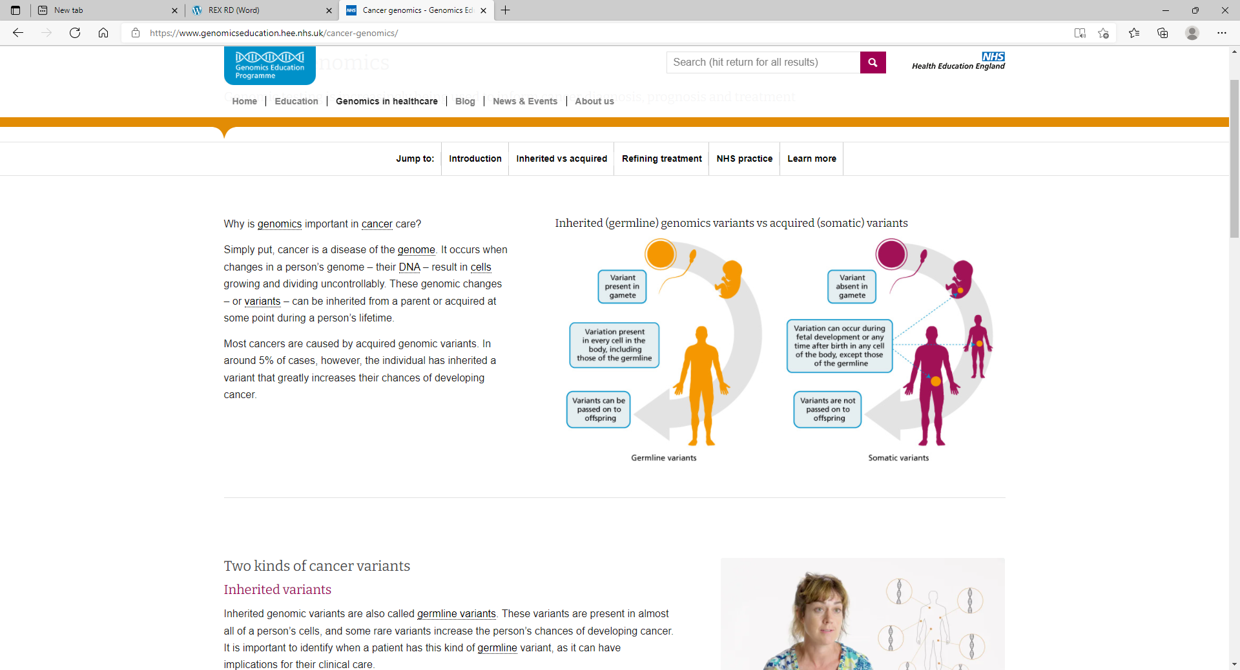
Germline vs Somatic variants?
Cancer genomics - Genomics Education Programme (hee.nhs.uk)

Slide 5
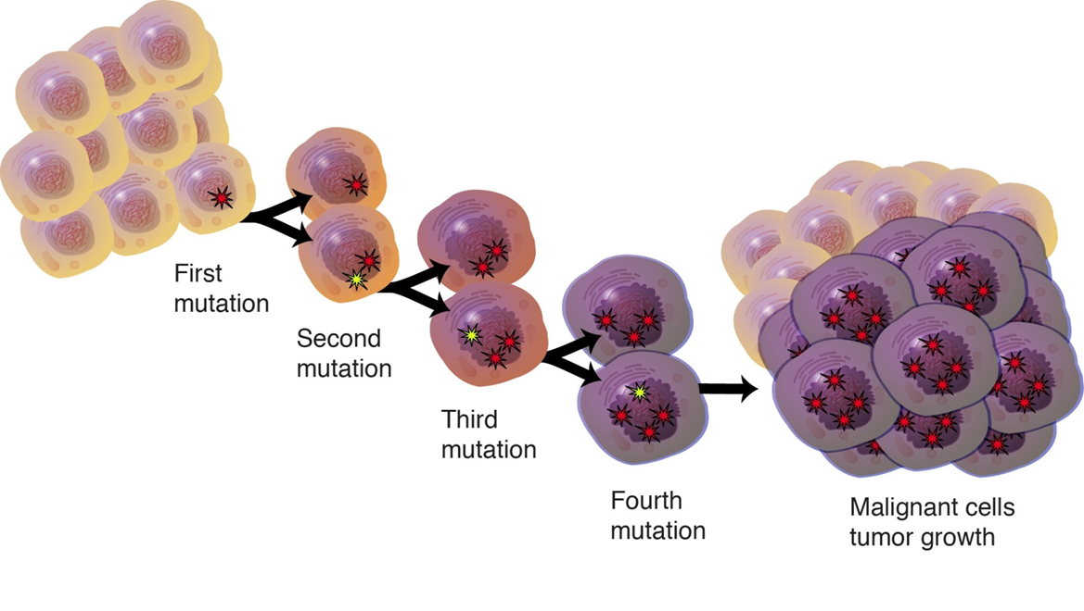
Cancer is a disease of the Genome
Most cancers arise via step-wise acquisition of many somatic genetic changes

Slide 6

Genetic tests
Clinical Exome
Gene
Exome
Chromosome
Genome
Whole Genome Sequencing
What is genomics? - Genomics Education Programme (hee.nhs.uk)

Slide 7

Legacy of 100 000 Genome Project -
National Genomics Medicine Service
NHSE – Re-procurement of Genetic Laboratory Services to underpin new Genomic Medicine Services – completed 2018
Development and issuing of Test Directory – Rare Disease and Cancer – latest update due any time.
Development of National Genomic Medicine Service
  GLHs
  GMSAs
  Clinical Genomics Services; new draft service specification
  Cancer
  Mainstream Specialties

Slide 8
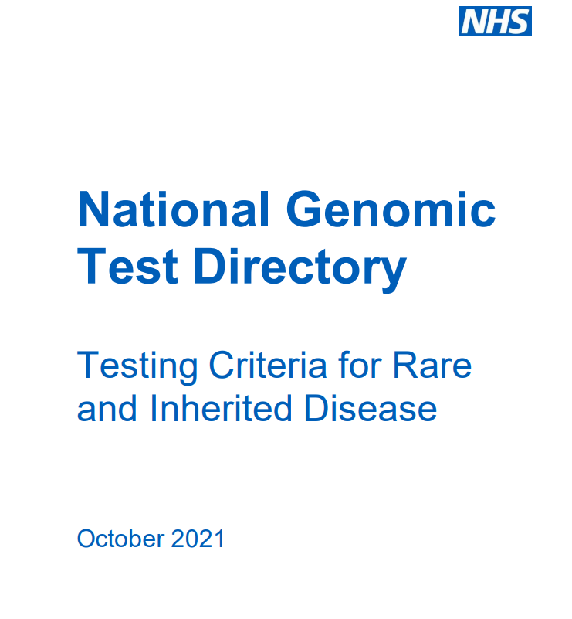
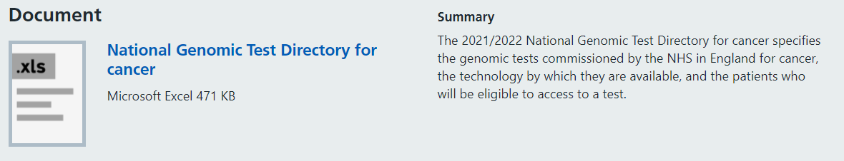
Test Directories
Rare Disease
Cancer
www.england.nhs.uk/publication/national-genomic-test-directories/

Slide 9

Rare Disease https://www.england.nhs.uk/wp-content/uploads/2018/08/rare-and-inherited-disease-eligibility-criteria-v4.pdf

Slide 10
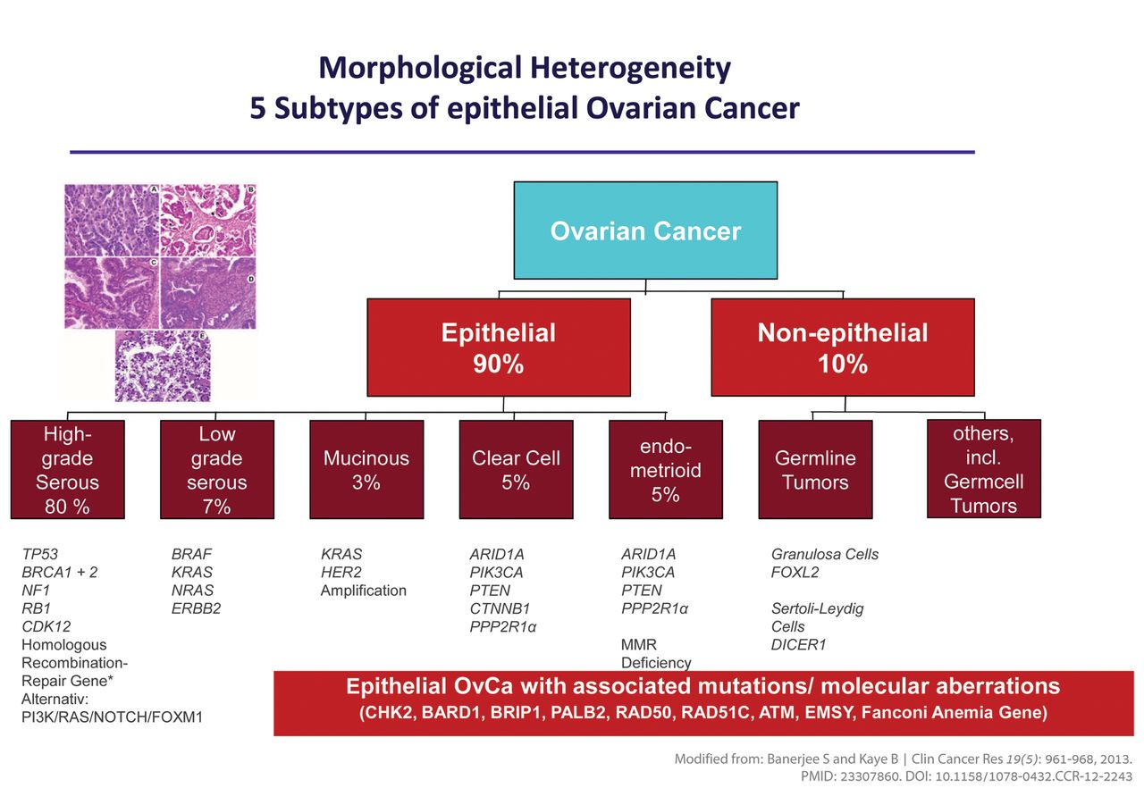


Ovarian cancer subtypes
FROM BIOPSY TO PERSONALISED CANCER CARE
GYNAECOLOGICAL CANCER GENOMICS WEBINAR

Slide 11
Somatic testing: Cancer test directory
Ovarian Carcinoma | M2.1 | Multi-target NGS panel - small variant (BRCA1, BRCA2, SMARCA4) | BRCA1, BRCA2, SMARCA4 | SNV: BRAF, ERBB2, MET exon 14 skipping CNV: ERBB2, MET | Small variant detection | Panel | Singleton | Known high grade serous ovarian carcinoma or In cases of diagnostic uncertainty of small cell carcinoma of the ovary
 | M2.3 | Multi-target NGS panel - structural variant (NTRK1, NTRK2, NTRK3) | NTRK1, NTRK2, NTRK3 | SV: ALK, BRAF, ROS1, MET (including exon 14 skipping) | Structural variant detection | Panel | Singleton | Patient's clinical status means they are eligible for an NTRK inhibitor in the event an NTRK rearrangement is detected.
 | M2.5 | HRD status (either positive for BRCA 1 and/or 2, or HRD positive) | BRCA1/2 and/or genomic instability |  | Mutational signature detection | Panel | Singleton | Patient is eligible for first line treatment and has a diagnosis of high grade ovarian cancer
S |  | Ovarian sex cord stromal tumours | M245.1 | Multi-target NGS panel-small variant (FOXL2, CTNNB1, APC, DICER1) | FOXL2, CTNNB1, APC, DICER1 | SNV: BRAF, ERBB2, MET exon 14 skipping CNV: ERBB2, MET | Small variant detection | Panel | Singleton | Molecular testing should be used where histological diagnosis is not possible. It is recommended that patients are reviewed at a Gynaecological cancer centre before requesting the genomic testing though a Genomic Laboratory Hub.
 |  | Endometrial Cancer | M215.1 | Multi-target NGS panel - structural variant (NTRK1, NTRK2, NTRK3) | NTRK1, NTRK2, NTRK3 | SV: ALK, BRAF, ROS1, MET (including exon 14 skipping) | Structural variant detection | Panel | Singleton | Patient's clinical status means they are eligible for an NTRK inhibitor in the event an NTRK rearrangement is detected
 |  |  | M215.2 | MLH1 promoter hypermethylation | MLH1 |  | Methylation analysis | Targeted mutation testing | Singleton | Known endometrial carcinoma, as per NICE Guidelines algorithm for molecular testing for Lynch syndrome. Please refer to Rare & Inherited disease directory R210 Lynch syndrome for full eligibility criteria.
 |  |  | M215.4 | Multi-target NGS panel - small variant (MLH1, MSH2, MSH6, PMS2) | MLH1, MSH2, MSH6, PMS2 | SNV: BRAF, ERBB2, MET exon 14 skipping CNV: ERBB2, MET | Small variant detection | Panel | Singleton | Known endometrial carcinoma, as per NICE Guideline's algorithm for molecular testing for Lynch syndrome and or no IHC result for Lynch testing. Please refer to Rare & Inherited disease directory R210 Lynch syndrome for full eligibility criteria.
 |  |  | M215.5 | Multi-target NGS panel-small variant detection (POLE) | POLE | SNV: BRAF, ERBB2, MET exon 14 skipping CNV: ERBB2, MET | Small variant detection | Panel | Singleton | Molecular assessment will aid diagnosis or management

Slide 12
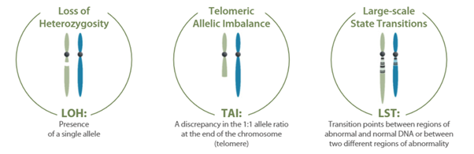
HRD testing
Homologous recombination deficiency (HRD) testing & tumour BRCA (tBRCA) genomic sequencing in ovarian carcinoma
and related FIGO stage III and IV cancers.
Cells with functional homologous recombination deficiency will have ‘genomic scarring’
FROM BIOPSY TO PERSONALISED CANCER CARE
GYNAECOLOGICAL CANCER GENOMICS WEBINAR

Slide 13
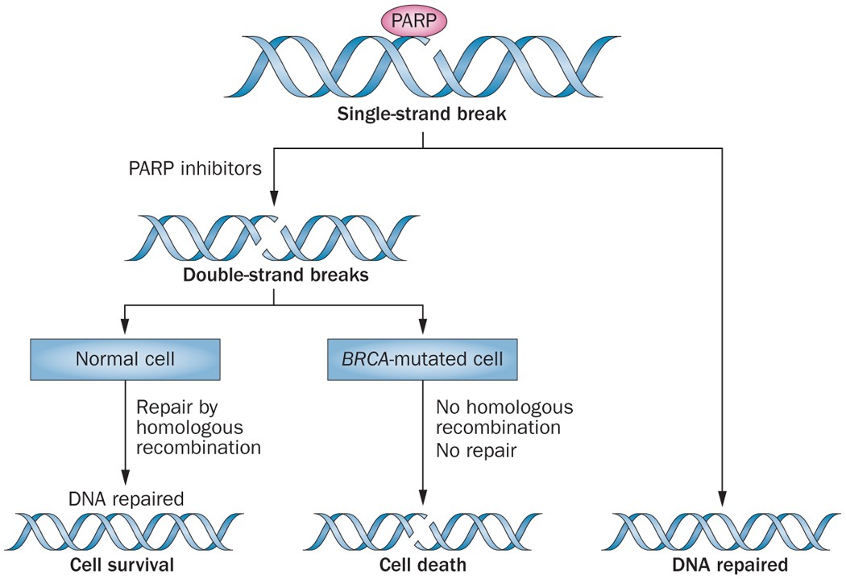
First Line Therapy –
maintenance PARP inhibitors
PARP inhibitors exploit homologous recombination deficiency
Work best in tumours that are HRD, and therefore the population more likely to be chemosensitive
Nature Reviews Clinical Oncology volume 12, pages27–41 (2015)

Slide 14
Mainstream genetic testing 1
R207 ovarian cancer without breast cancer
  Testing Criteria
    1. High grade non mucinous epithelial ovarian cancer (EOC) at any age OR
    2. Epithelial ovarian cancer (EOC) AND
      a. ≥1 first degree relative with EOC, OR
      b. ≥1 second degree relative with EOC (intervening relative is male, OR female with BSO, OR female deceased) OR
      c. ≥2 second / third degree relatives with EOC
    3. Deceased affected individual (proband) where criteria 2 are reached (or family Manchester score of 20) and:
      a. Appropriate tissue is available (tumour or normal) AND
      b. No living affected individual is available for genetic testing

Slide 15
Mainstream genetic testing 2
R208 breast cancer and ovarian cancer
1. Living affected individual (proband) with breast* or high grade ovarian cancer where the individual +/- family history meets one of the criteria. The proband has:
  a. Breast cancer (age <40 years, excluding grade 1 breast cancers), OR
  b. Bilateral breast cancer (age < 50 years), OR
  c. Triple negative breast cancer (age < 60 years), OR
  d. Male breast cancer (any age), OR
  e. Breast cancer (age <45 years) and a first degree relative with breast cancer (age <45 years), OR
  f. Combined pathology-adjusted Manchester score ≥15 or single gene pathology adjusted score of ≥10 or BOADICEA/CanRisk score ≥10% OR
  g. Ashkenazi Jewish ancestry and breast cancer at any age
2

Slide 16
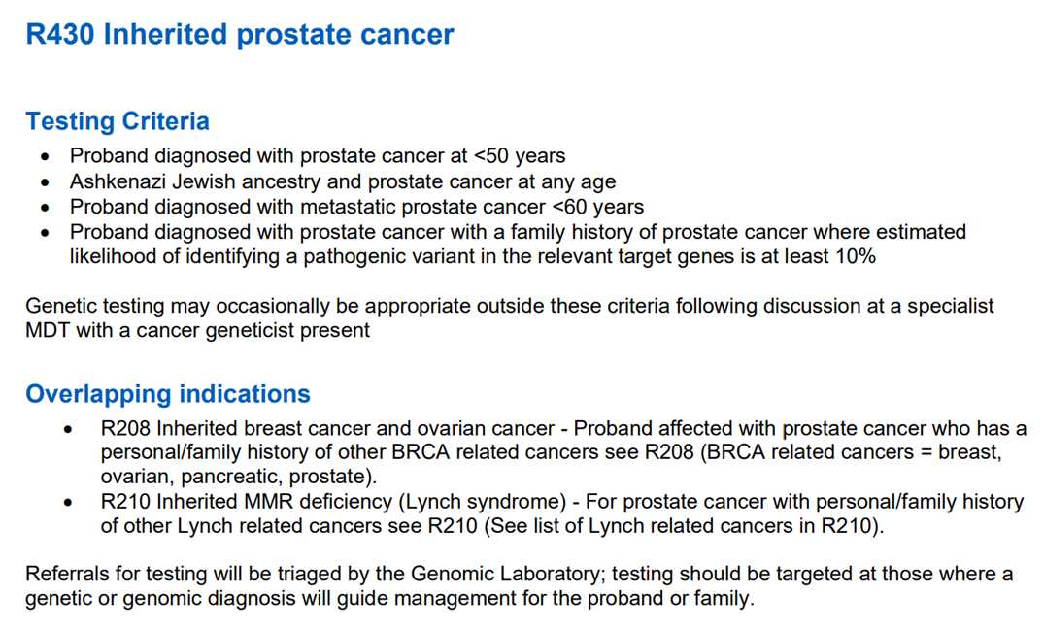
Mainstream genetic testing 3
Prostate Cancer Gene Panel
BRCA1, BRCA2, MSH2, MSH6, ATM, PALB2

Slide 17
Mainstream genetic testing 4
R210 Inherited MMR deficiency (Lynch syndrome)
Testing Criteria
  All new diagnoses of colorectal and endometrial cancer should have tumour MSI / IHC as outlined in the cancer test directory and the Lynch syndrome handbook for Alliances in order to identify dMMR tumours and additional testing that suggests Lynch Syndrome. This may include BRAF testing in MLH1 deficient colorectal cancers and somatic MLH1 hypermethylation testing in BRAF negative colorectal cancers and all MLH1 deficient uterine cancers. Somatic MLH1 hypermethylation testing is included on the Cancer Test Directory under M1.5.
  1. Clinical Criteria for germline testing in an affected individual
    The proband has a dMMR tumour where results of additional testing suggest Lynch syndrome. This may include BRAF testing in MLH1 deficient colorectal cancers and somatic MLH1 hypermethylation testing in BRAF negative colorectal cancers and all MLH1 deficient uterine cancers
    a. The affected proband comes from a modified Amsterdam criteria positive family irrespective of the dMMR status of the tumour
    b. Personal or family history suggestive of Constitutional Mismatch Repair Deficiency (CMMRD) with Wimmer score =>3
    c. Deceased affected individual meets criteria and a previously stored constitutional blood/DNA sample is available.

Slide 18
You’re not on your own!
Mainstreaming Genomic Testing is about personalising treatment
Testing at as early a point in the patient journey as possible.
Targeting with available treatments
Subject to change as evidence evolves.
Somatic testing: does not require consent
Germline testing:
We are working on better ways for embedding test requests and receiving results.
We have models for e-consent/making the process as simple as possible.
Results:
Most results will be straight forward
Local genetics teams will support interpretation of results and ideally need to see all patients (or their relative) with a germline variant. If there is a suspicion of a familial condition but testing to date is negative, still consider a referral to genetics.
GLH host a GTAB (genomic tumour advisory board) for solid tumours and inherited cancer predisposition.

Slide 19
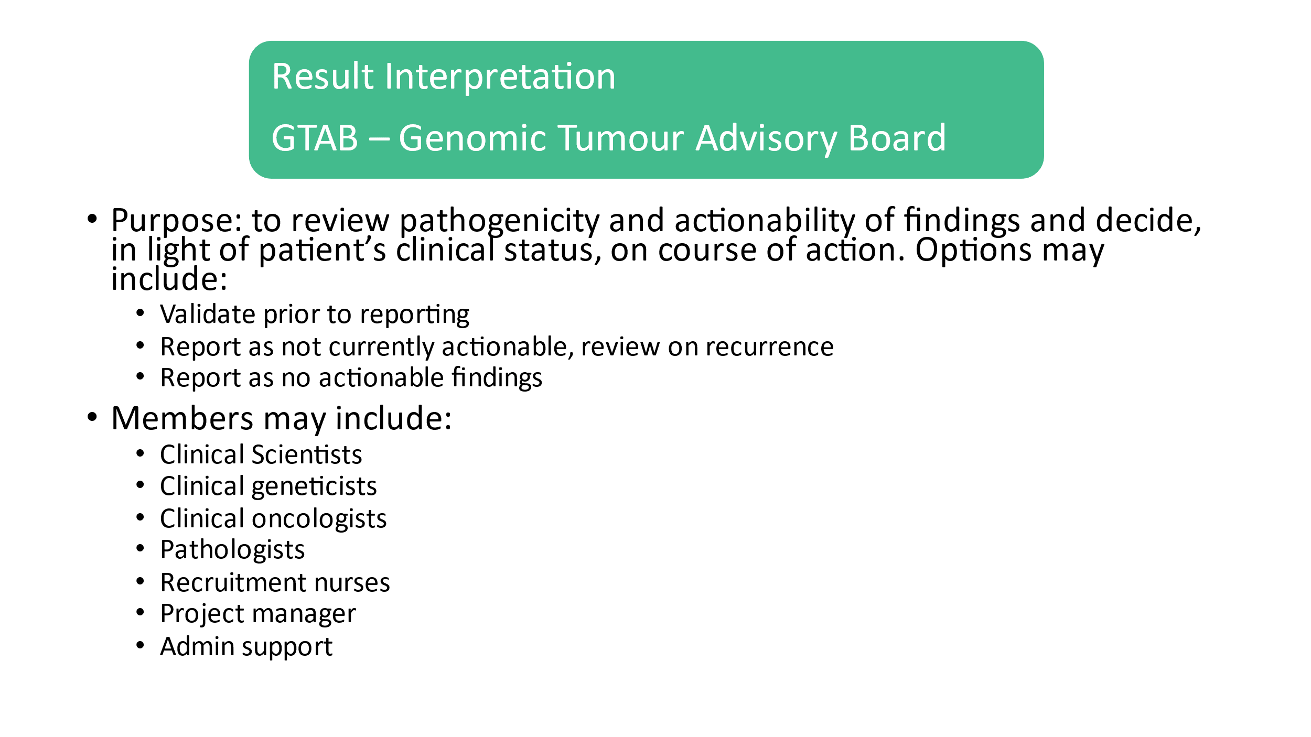
GTAB
3 GTABs run by GLH:
  Inherited cancers for discussion of germline/possible germline findings from testing
  Solid tumours GTAB to discuss results of testing and possible targetable mutations
  Haemonc GTAB as above
Anyone can send a request for discussion in and attend

Slide 20
Referring to clinical genetic services
The primary role of clinical genetic services is to diagnose, support, and counsel families with possible or known inherited disorders, including:
  Diagnostic assessment
  Accurate, current medical information
  Genetic counselling
  Management and support to individual patients of any age
To make a referral within:
Cheshire, Merseyside, or the Isle of Man. Cheshire and Merseyside Genetic Services which comprises the Liverpool Centre for Genomic Medicine (LCGM) service as well as Laboratory Services
https://www.liverpoolwomens.nhs.uk/our-services/liverpool-centre-for-genomic-medicine-lcgm

Slide 21


Genetic Counselling
“The process of helping people understand and adapt to the genetic, medical, psychological and familial implications of the genetic contributions to disease.”
Different forms of testing ie diagnostic, predictive, carrier, prenatal
Education
Counselling around decision making
Psychosocial aspects of genetic testing
Training
Point of contact for support

Slide 22

Family history
Quick summary of family members medical history
Can see how closely related individuals are
Helps to introduce the idea that results may have implications for other family members
Helpful if referred to other services ie us!

Slide 23
Case Study – endometrial cancer

Slide 24
Case Study – ovarian cancer

Slide 25
Endometrial Cancer
Endometrial cancer is identified, biopsy taken and reflex MisMatch Repair ImmunoHistoChemistry (MMR IHC) is completed
Test to identify if the MMR proteins are present in the tumour
If MMR proteins are missing then this could mean the individuals has Lynch syndrome and genetic testing is available
Endometrial cancer can also be associated with other conditions such as PTEN therefore in rare cases can have other genetic causes

Slide 26
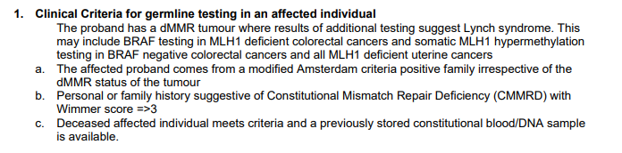
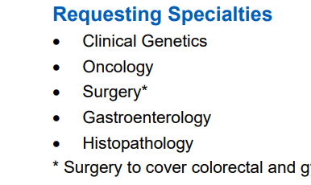
National Test Directory https://www.england.nhs.uk/publication/national-genomic-test-directories/

Slide 27
Lynch Syndrome Panel (R210)
MLH1
Bowel, Endometrial and Ovarian cancer
MSH2
Bowel, Endometrial and Ovarian cancer
MSH6
Bowel Endometrial and Ovarian cancer
PMS2
Bowel and Endometrial cancer

Slide 28
Lynch Related Cancers
Main cancers we see are
  Bowel Cancer
  Endometrial Cancer
  Epithelial Ovarian Cancer

Slide 29
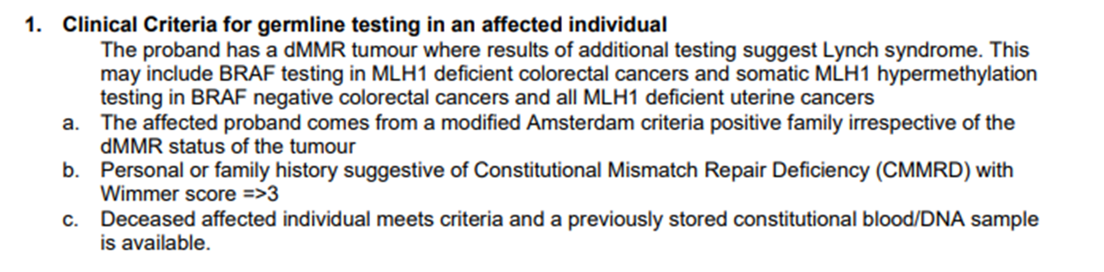
Amsterdam Criteria
3 individuals with a Lynch related cancer;
2 over 2 generations;
1 person under 50.

Slide 30
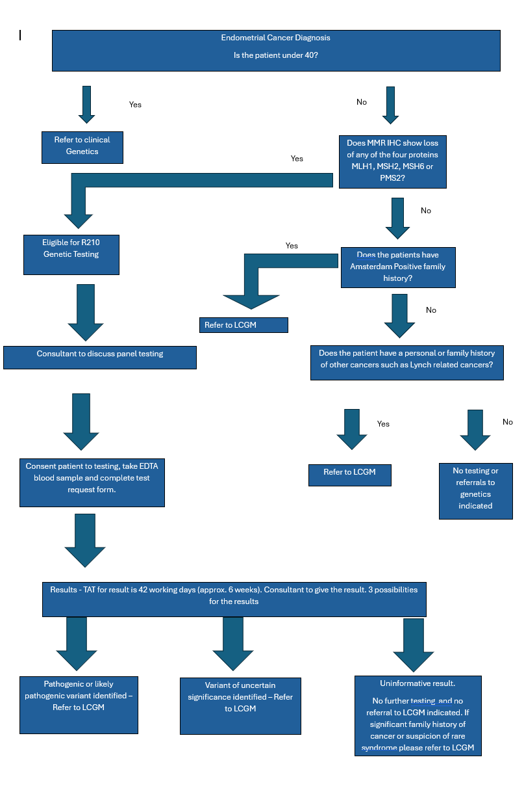
Flowchart

Slide 31
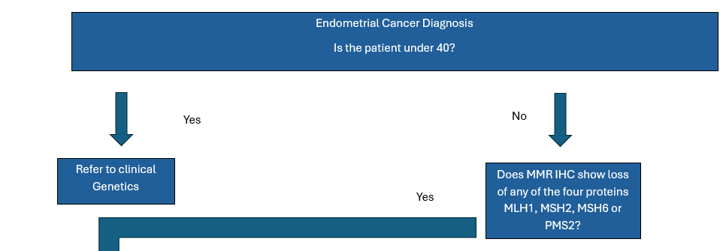
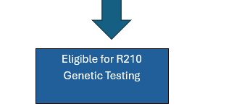

Slide 32
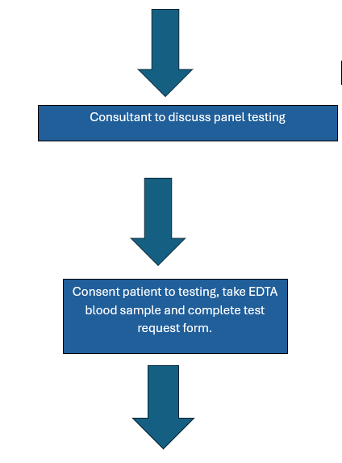

Slide 33
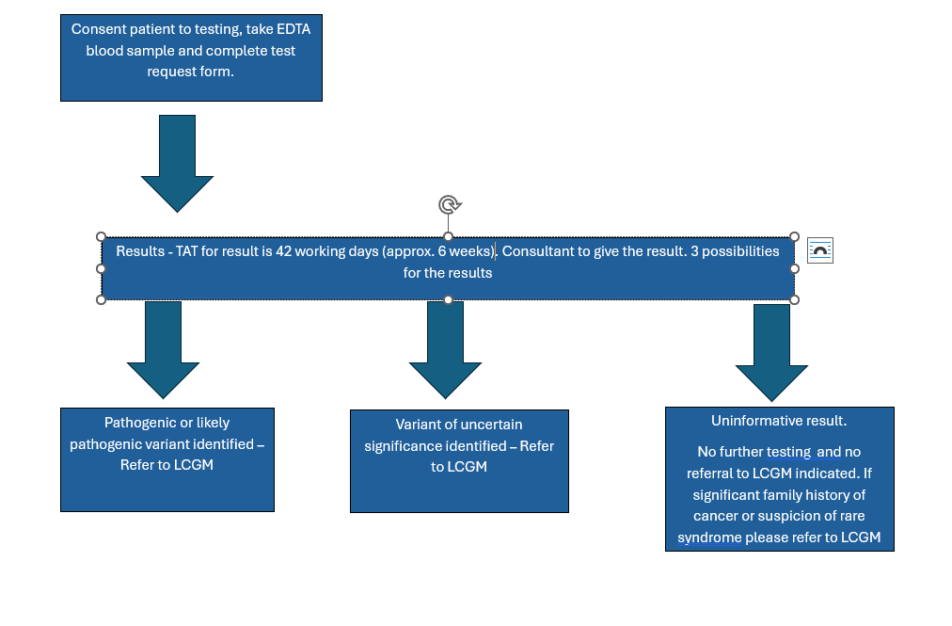

Slide 34
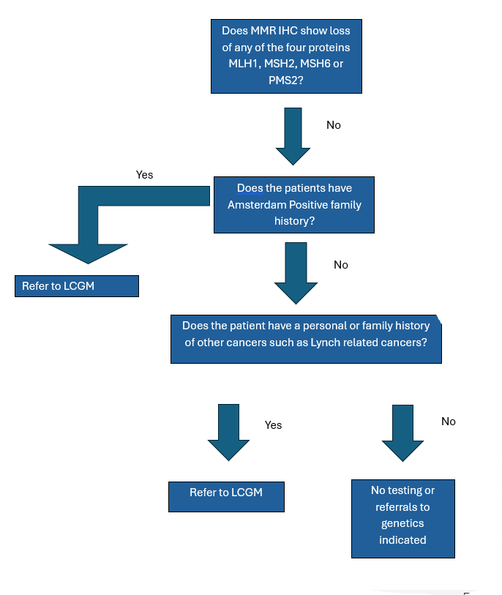

Slide 35
Ovarian cancer
Different types of ovarian cancer
  epithelial (serous, mucinous etc)
  non-epithelial
Type of ovarian cancer can be suggestive of an inherited genetic contribution
Variants in the BRCA1 and BRCA2 genes are a common cause of Homologue recombination deficiency (HRD)

Slide 36
Inherited ovarian cancer panel (R207)
BRCA1, BRCA2, PALB2
High risk breast/ovarian cancer (prostate and pancreatic)
RAD51C, RAD51D
Moderate – high risk breast/ovarian cancer
BRIP1
High risk ovarian cancer
MLH1, MSH2, MSH6
High risk ovarian, endometrial and bowel cancer
(Lynch syndrome)
www.panelapp.genomicsengland.co.uk/

Slide 37
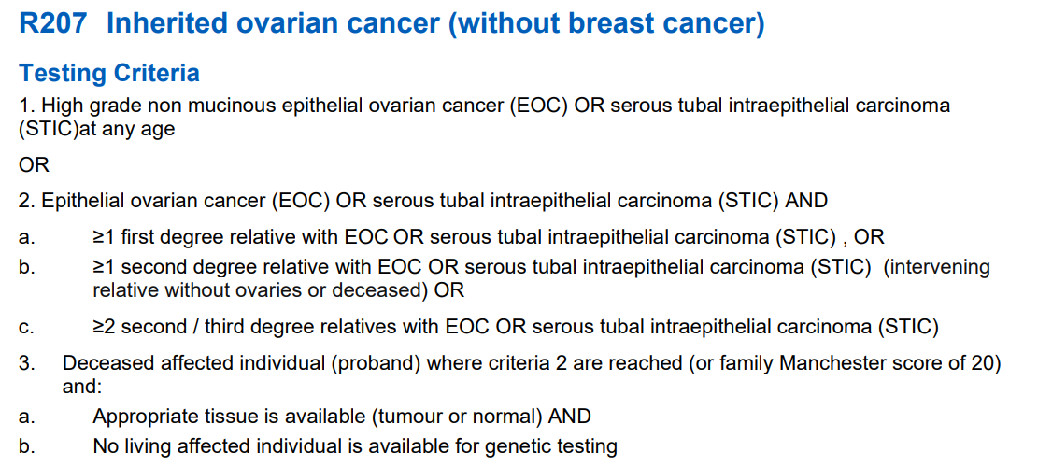
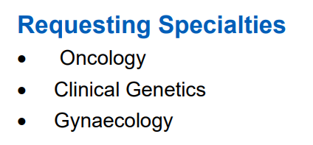
National test directory

Slide 38
First degree relatives (FDR)
Parents
Sibling
Children
NB: Relative without ovaries = male, or female relative with bilateral oophorectomy

Slide 39
National test directory

Slide 40
Second degree relatives (SDR)
Grandparents
Aunts/uncles
Nieces/nephews
Grandchildren

Slide 41
National test directory

Slide 42
Third degree relatives (TDR)
Great grandparents
Cousins

Slide 43
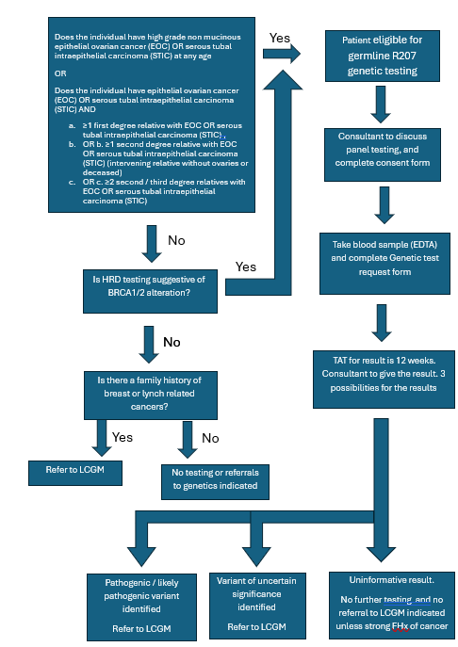
Ovarian cancer flowchart

Slide 44
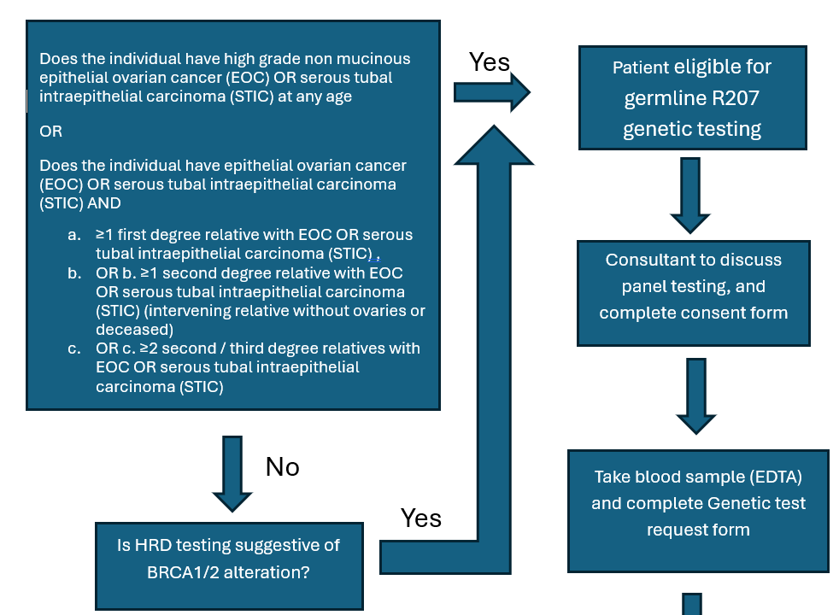

Slide 45
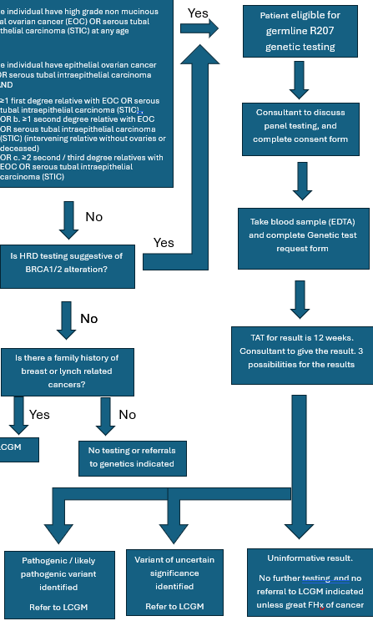

Slide 46
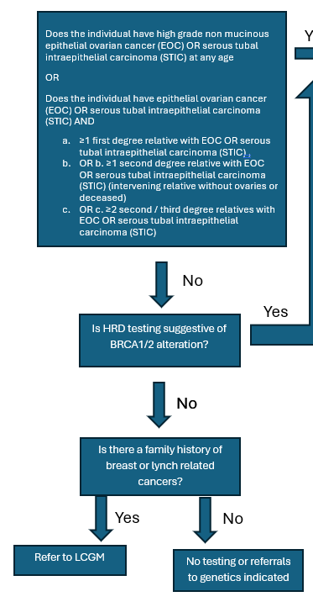

Slide 47

Consenting

Slide 48
Discussion in clinic
Your biopsy results show there could be an inherited cause to your cancer. We can offer you a genetic test to see if this is the case.
The results of this genetic test may influence your treatment options after surgery, it may also be relevant for you family member.
The genetic test may show that you have a genetic alteration that explains your cancer and you may be at risk of other cancers. If this is the case, we will refer you to genetics to discuss this further.
The genetic test may not find a genetic alteration, which is reassuring for you and your family.
The genetic test may find a gene alteration we don’t fully understand, and we will refer you to genetics to discuss further.
If this is something you are interested in, we can organise this today by giving a blood sample.
Or you can take this pack away, and let us know.

Slide 49
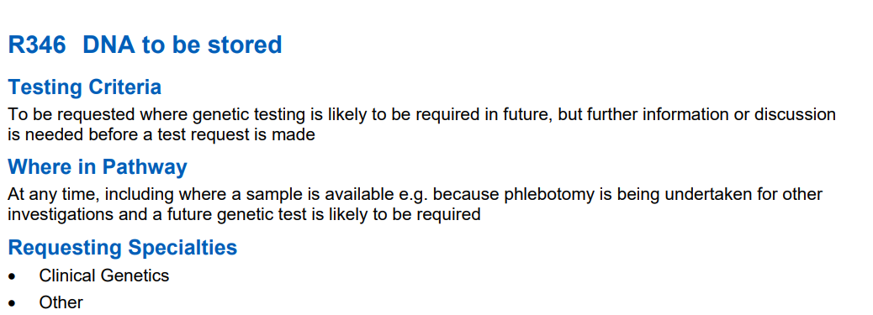
Storing DNA
Benefits of taking a blood sample to stored DNA
  Time to consider option of testing i.e. if currently in treatment / unwell
  Information for relatives to access

Slide 50
FAQ
Where do I find the consent form?
Where do I find the blood form?
How do I complete the form?
Where do patients give bloods for test?
How long do results take?
How long does it take for a patient to be seen when referred to clinical genetics?
Who do I contact if I have general questions about genetic testing or questions about a patient?
Where can we direct patients for further support?

Slide 51


Where do I find the consent form?

Slide 52
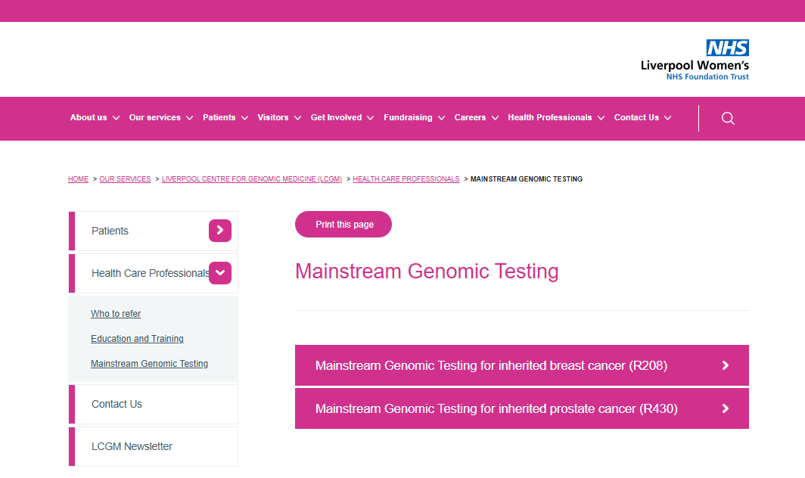
Where do I find the blood form?
www.liverpoolwomens.nhs.uk/our-services/liverpool-centre-for-genomic-medicine-lcgm/health-care-professionals/mainstream-genomic-testing/

Slide 53
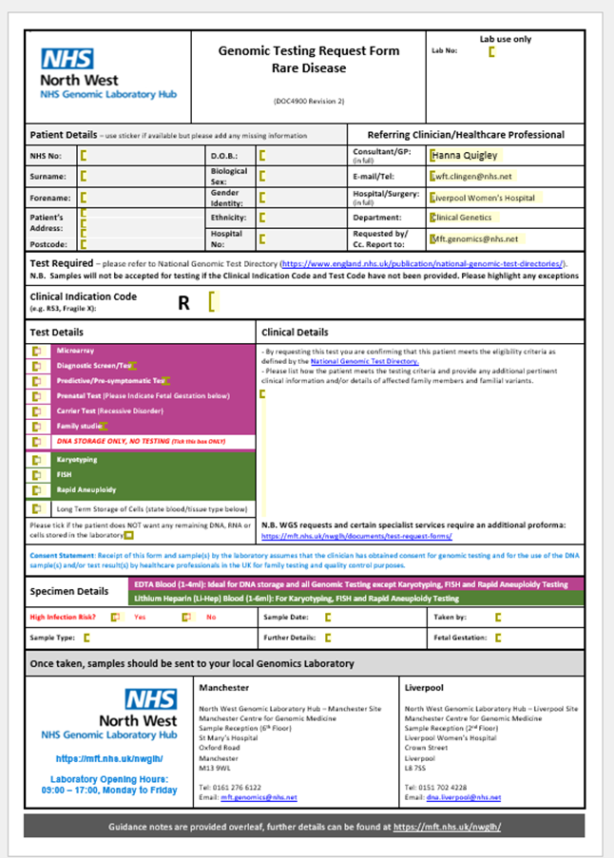
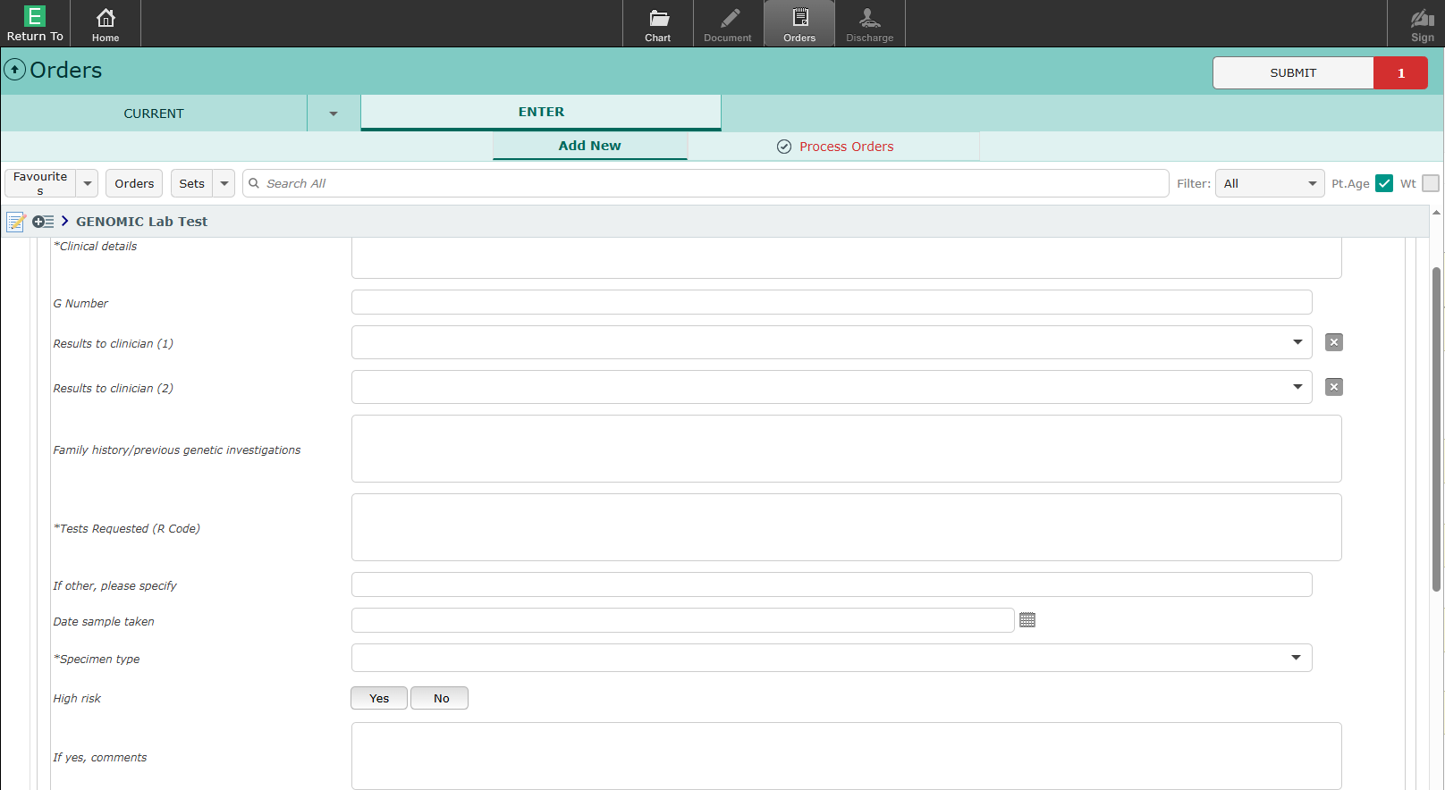
Where do I find the blood form?
www.liverpoolwomens.nhs.uk/our-services/liverpool-centre-for-genomic-medicine-lcgm/health-care-professionals/mainstream-genomic-testing/

Slide 54
How do I complete the form?

Slide 55
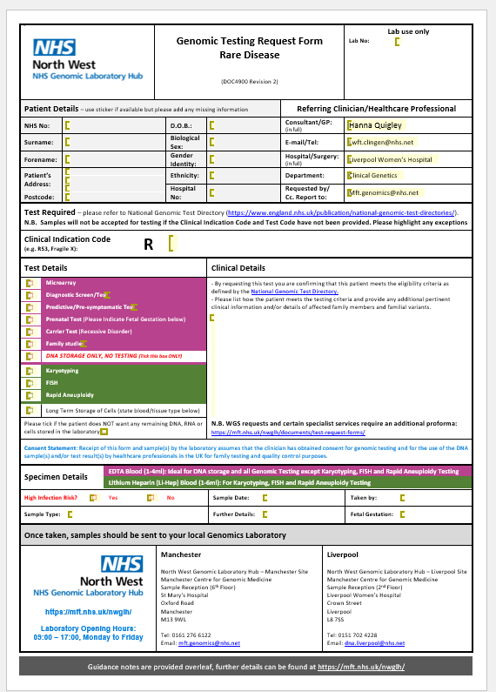
How do I complete the form?
Patient details
R code
(R207 or R210)
Testing category:
Diagnostic
(Colour also indicates the tube needed)
Clinical details
E.g. diagnosed with endometrial cancer under 50
Sample type
Blood – EDTA

Slide 56
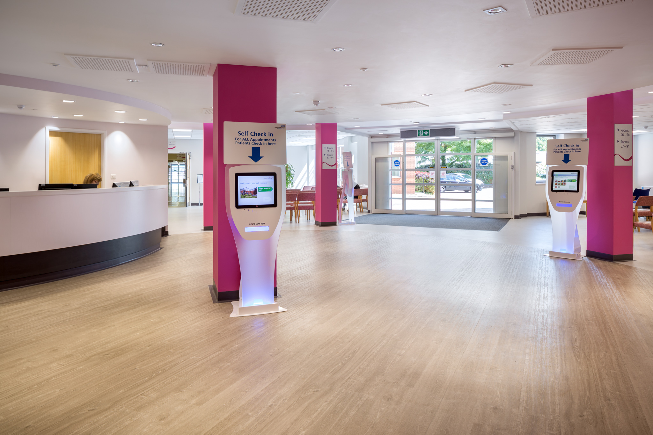
How do patients have bloods taken?
Gynaecology outpatient department

Slide 57
How long do results take?
Routine testing can take up to 42 calendar days (6 weeks)
Can be prioritised if it will impact on treatment (write this on form)

Slide 58
How long does it take for a patient to be seen when referred to clinical genetics?
Treated as a priority referral
Recent update in LGCM
Will be booked into an appointment within 8 weeks

Slide 59
Who do I contact if I have general questions about genetic testing or questions about a patient?
For any urgent queries:
On duty Genetic Counsellor
0151 802 5008
Lwft.clingen@nhs.net
For routine queries:
Samara Delamere
Samara.delamere@lwft.nhs.uk
Hanna Quigley
Hanna.Quigley@lwft.nhs.uk

Slide 60





Where can we direct patients for further support?
General cancer support
Macmillan
Sunflowers
Maggies
www.patientinfolibrary.royalmarsden.nhs.uk/lynchsyndrome - Beginners guide to Lynch

