Slide 1
Local processes and logistics
Dr Shaun Tolan
Clinical Oncologist
The Clatterbridge Cancer Centre

Slide 2
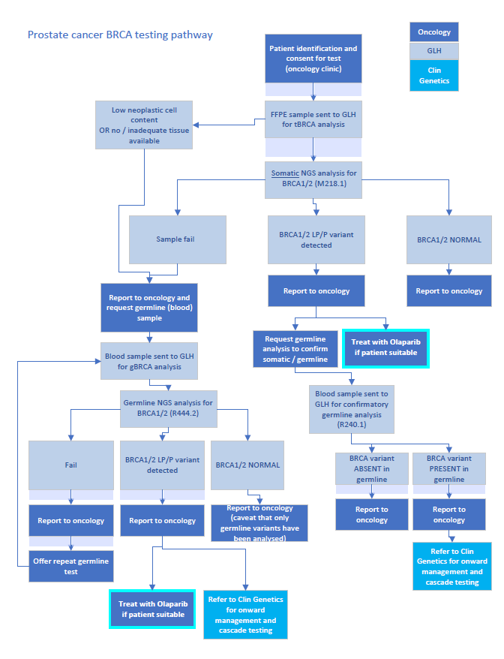
There are two main clinical scenarios where men with prostate cancer may have genomic analysis performed:
Somatic analysis, i.e. testing of biopsy or prostatectomy tissue to look for BRCA1 and 2 variants in the tumour which could result in treatment with olaparib as 2nd or 3rd line in mCRPC
Germline analysis, i.e. testing of peripheral blood lymphocytes to check inherited BRCA1 and 2 variants in the germline (heathy cells)
The interplay of these scenarios is shown in the flow chart.

Slide 3
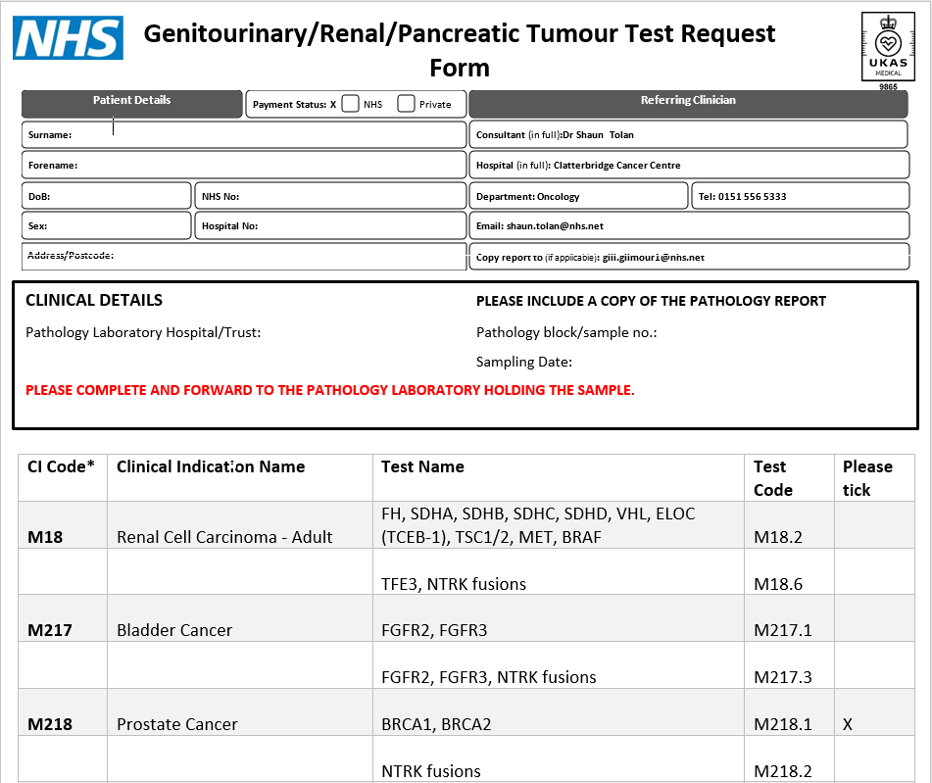
To arrange somatic analysis complete this form and send via email, along with the pathology report, to the local histopathology laboratory.
Use M218.1 code and not M218.2.
The lab will forward the specimen to the central Genomic Laboratory Hub.
Once available, the report with the result will be emailed to you along with a copy to a designated other person if included on the form.
Please do not reply to the account sending you the result. If you have any questions about its content email mft.genomics@nhs.net

Slide 4
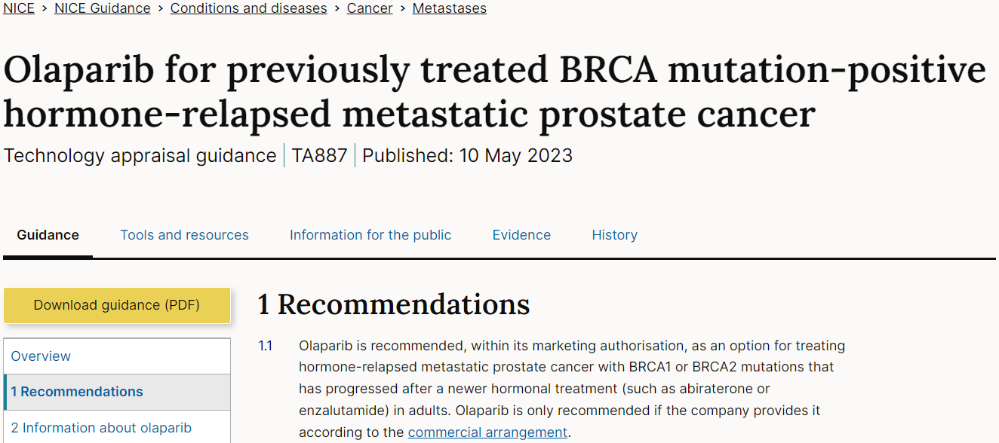
If a somatic BRCA1 or 2 variant is detected, olaparib can be prescribed after progression on 1st line treatment.
NHS-E Cancer Drug Fund Blue-Teq form is required.
The patient should be counselled and offered germline analysis to check if the variant is also present in the germline.

Slide 5
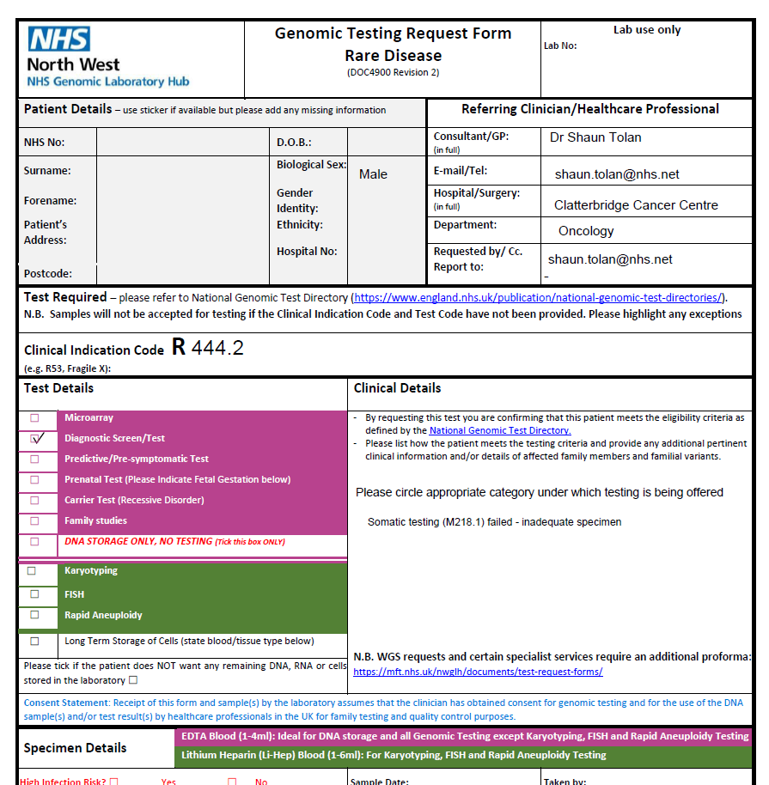
Due to the nature of archived prostate biopsy and prostatectomy specimens, it is common for the somatic testing result to return as ‘Analysis failed – inadequate specimen’.
In this situation the patient is eligible for germline analysis using the R444.2 code. The patient should be counselled and testing offered if agreeable.
Send the blood form to your local CCC treatment hub and book a BRCA blood test using T&M in Meditech

Slide 6
Germline testing is looking at inherited prostate cancer (R430 indication)
The testing criteria for those at higher risk are:
• Proband diagnosed with prostate cancer at <50 years
• Ashkenazi Jewish ancestry and prostate cancer at any age
• Proband diagnosed with metastatic prostate cancer <60 years
• Proband diagnosed with prostate cancer with a family history of prostate cancer where estimated likelihood of identifying a pathogenic variant in the relevant target genes is at least 10%
Genetic testing may occasionally be appropriate outside these criteria following discussion at a specialist MDT with a cancer geneticist present.
After counselling and consent, the pathway is the same as for the R444.2 request:
Use the R430 request form and send to
local CCC treatment hub.
Book a BRCA blood test via T&M in Meditech.

Slide 7
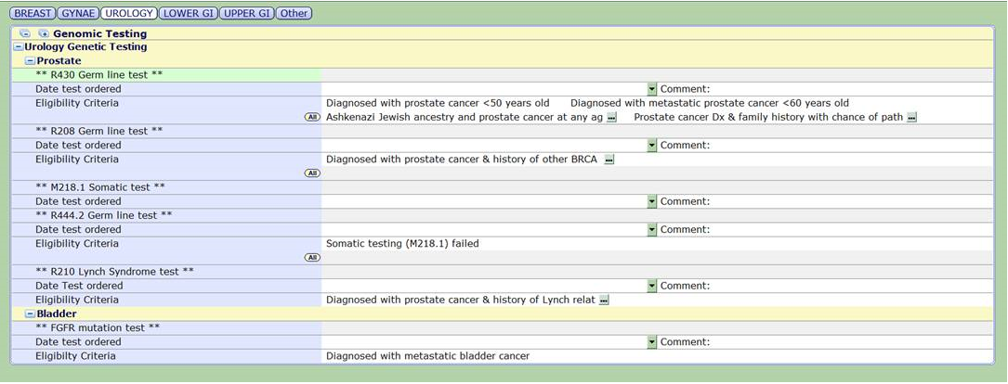
There are overlapping indications, e.g. R208 – patient with prostate cancer and personal/family history of BRCA cancers, and R210 – patient with prostate cancer and personal/family history of MMR deficiency (Lynch syndrome). It is important to use the correct code as different genes will be tested for.
The relevant testing codes will be available in Meditech – currently under development.

