Slide 1
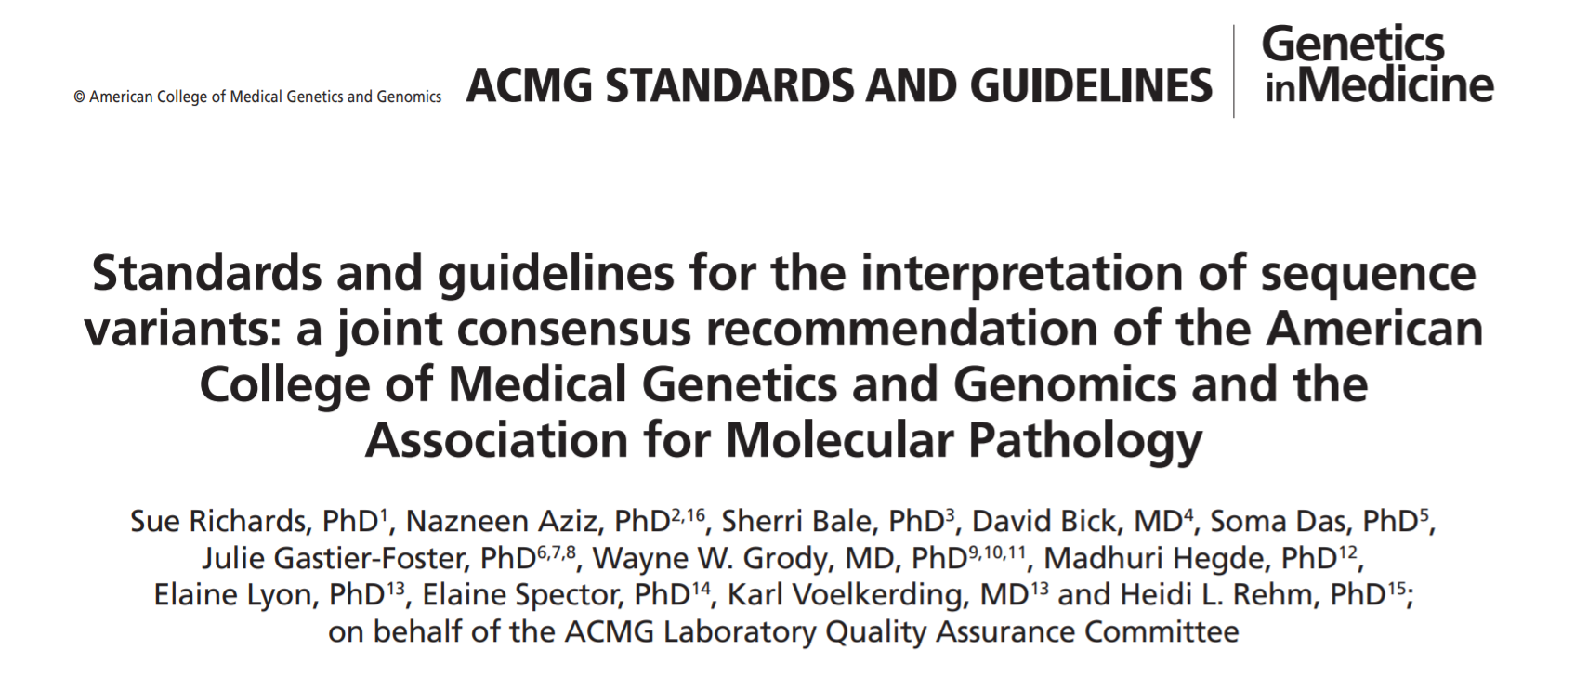
Possible genetic test results
All variants identified during the genetic testing process are analysed using the guidelines published by the American College of Molecular Genetics and Genomics (ACMG)
Link to paper: https://doi.org/10.1038/gim.2015.30

Slide 2
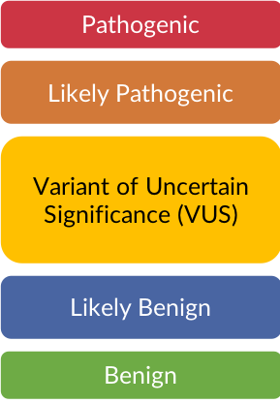
Possible genetic test results
All identified variants are assigned to one of five categories:

Slide 3
Possible genetic test results
There are three potential outcomes of the genetic testing process:
A disease-causing variant is identified
No clinically relevant variants are identified
A variant of unknown significance is identified

Slide 4
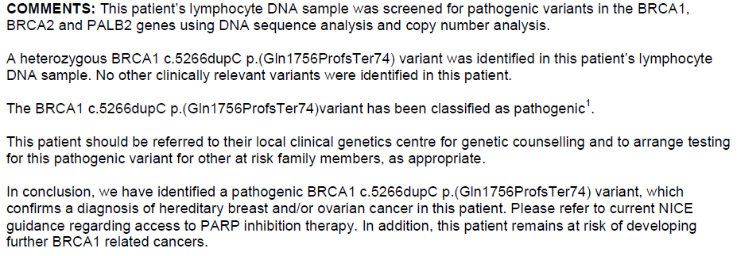
1) A disease-causing variant
Inherited genetic cause identified
Pathogenic / likely pathogenic variant

Slide 5
2) An uninformative result
Inherited genetic cause not identified – chance is reduced but not excluded
There may be a variant that has not been identified due to the limitations of the current laboratory technology.
There may be an variant in a gene which hasn’t been tested.

Slide 6
3) A variant of unknown significance
In some cases, there is not enough evidence available to classify a variant as pathogenic/likely pathogenic or benign/likely benign. These variants are known as variants of unknown significance (VUS).

Slide 7
3) A variant of unknown significance
A VUS is a variant in the gene sequence with unknown consequences in terms of the function of the gene product and the risk of disease.
A VUS can fall anywhere along the spectrum of being close to ‘likely benign’ to being close to ‘likely pathogenic’:
As a result, only variants that are classified as pathogenic/likely pathogenic should be used to direct clinical management.
This also means predictive genetic testing for a VUS cannot be offered to the patient’s wider family.
All variants of unknown significance will be kept under review by the laboratory team. The laboratory will automatically be notified if the classification of a variant has changed to ‘likely pathogenic’ or ‘pathogenic’ and they will issue a new genetic test report for any patient in their database who carries this re-classified variant. The clinician who receives the new genetic test report will be responsible for sharing this information with the patient.
*If genomic testing identifies a VUS, please refer to Clinical Genetics and discuss with Laboratory who will be able to provide guidance on interpretation, and any next steps that may be required e.g. further testing*

Slide 8
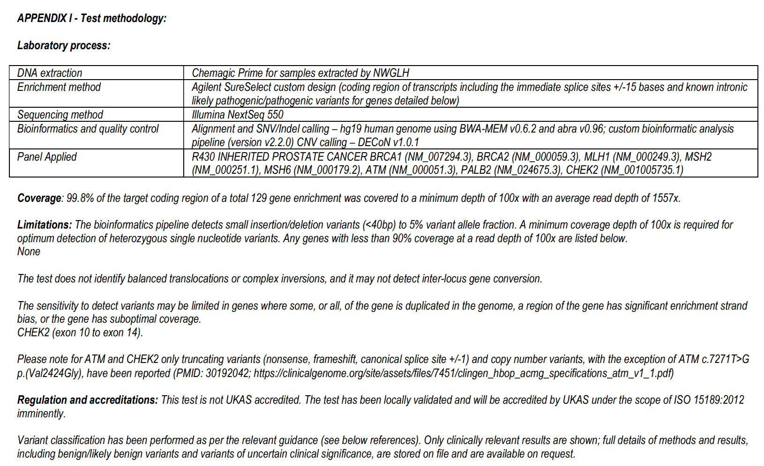
Check the small print…..
The ‘notes’ section on the laboratory report contains details of what testing was performed, what genes were examined, the quality parameters of the test and the limitations of the test:

Slide 9
Giving the test result
Practical considerations when giving the genetic test result:
Check the test report prior to the results appointment;
Consider having the report checked/witnessed by a 2nd clinician;
Disclose the result at the start of the appointment;
Confirm the name and date of birth of patient and cross-check details against the genetic test report, before disclosing the result;
State the result in simple terms i.e. leave no room for ambiguity;
Recognise that the result can provoke a range of emotions and meet the patient with empathy
Anger
Blame
Fear
Acceptance
Grief
Uncertainty
Relief
Guilt
Sadness

Slide 10
Responsibilities of the clinician
The clinician giving the test result will need to explain what the result means for the patient
e.g. will the result change their treatment recommendations?
All patients who are found to have a pathogenic gene variant should be referred to their local Genomic Medicine Service for a full implications discussion:
Does the result change their cancer risk?
What management options are available to them?
What are their reproductive options?
What support groups are available to them?
Are they eligible for any research trials?
What does this mean for their family members?

Slide 11
If you have any questions about the genetic testing process or the interpretation of the genetic test result, please contact: The North West Genomics Laboratory Hub on mft.genomics@nhs.net or The Genetic Counselling team at the Liverpool Centre for Genomic Medicine on lwft.clingen@nhs.net

