Slide 1




The test: purpose of and process of ordering germline testing
Tanya Davis, HCPC Registered Genetic Counsellor, CS021450
Liverpool Centre for Genomic Medicine
The best people, giving the safest care, providing outstanding experiences
Notes:
In this talk, we will cover some pf the practical aspects of testing

Slide 2


Overview
Sample requirements
Time frames
Sample storage in lab
Test request paperwork
Notes:
We will cover sample requirements
Expected time frames to get a result
Sample storage in the laboratory
And we will cover the paperwork that needs to be completed to go along with the sample

Slide 3
Sample requirements
Venous Blood: use EDTA tube only
  4ml for adults (BD Vacutainer preferred)
Saliva Samples: GeneFiX or Oragene collection kits only
Other Sample Types: by prior arrangement only
Notes:
Sample requirements
Venous blood sample, collected in an EDTA tube. Usually require around 4 mls
This is the preferred way obtain the sample. However, if patients have a problem with having blood samples taken it can be done using a saliva collection kit. Its important to note that only specifics saliva kits can be used
If you have any questions about this, you can contact the lab for advice. They would also be able to advise you as to whether there were any other sample types would be appropriate

Slide 4
Time frame and sample storage
Results will take approximately 6 weeks
DNA will be stored in lab in case further testing is required unless patient opts otherwise
Notes:
Result are expected to take around 6 weeks from when the lab receives the sample
When the lab receive the sample they will store any DNA not used for the test unless the patients opts out of this. This is so that an additional sample does not need to be taken from the patient if further testing is indicated. However, the patient has the option to opt out of this. We will cover how you can request for the lab to not store a patient's DNA later in this presentation

Slide 5
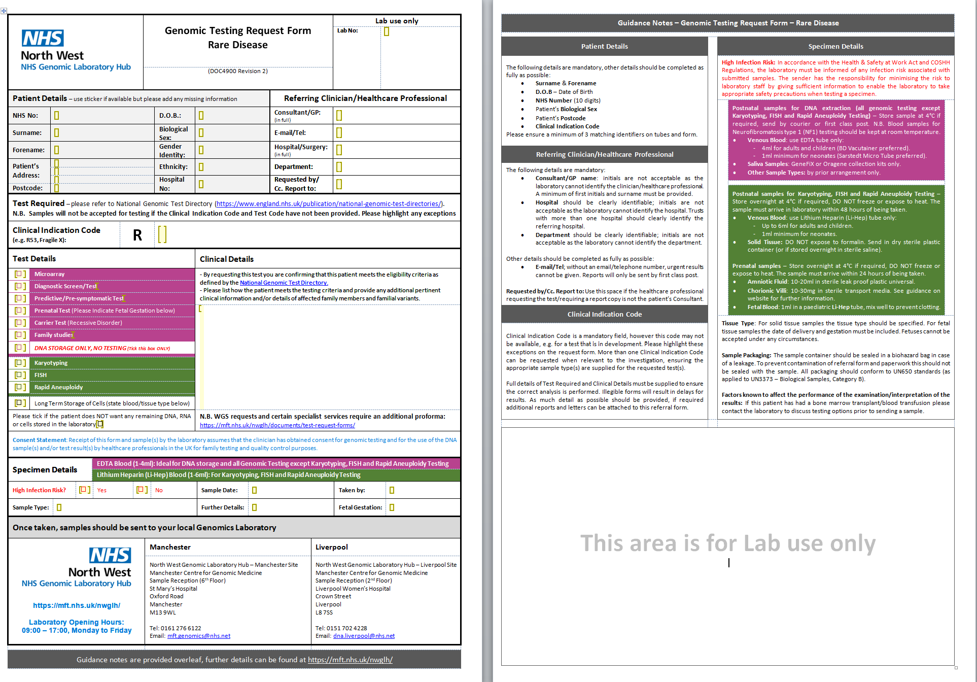
Genetic test request form
Notes:
Now we will move on to the genetic test request form. It is a two-sided document. The front of the form which you can see on your left, is the part you need to complete
The back of the form provides guidance on how to complete the form

Slide 6
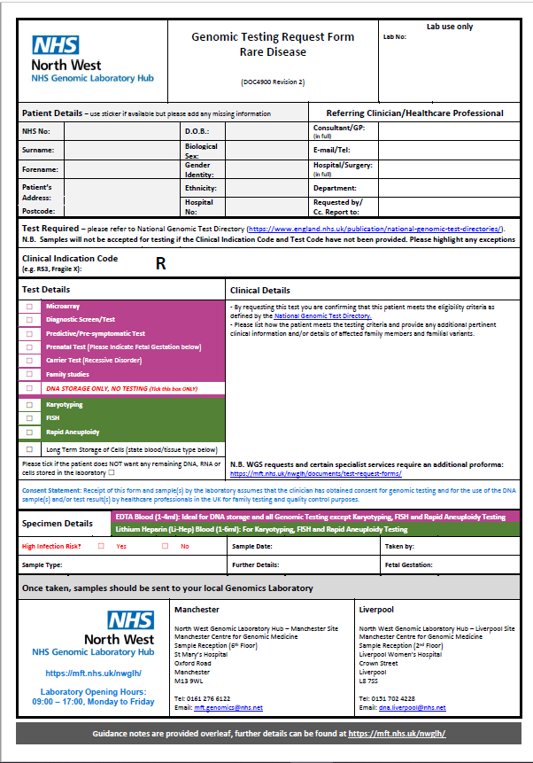
Patient demographics
Notes:
Firstly, the patient demographics which can be found at the top of the form

Slide 7
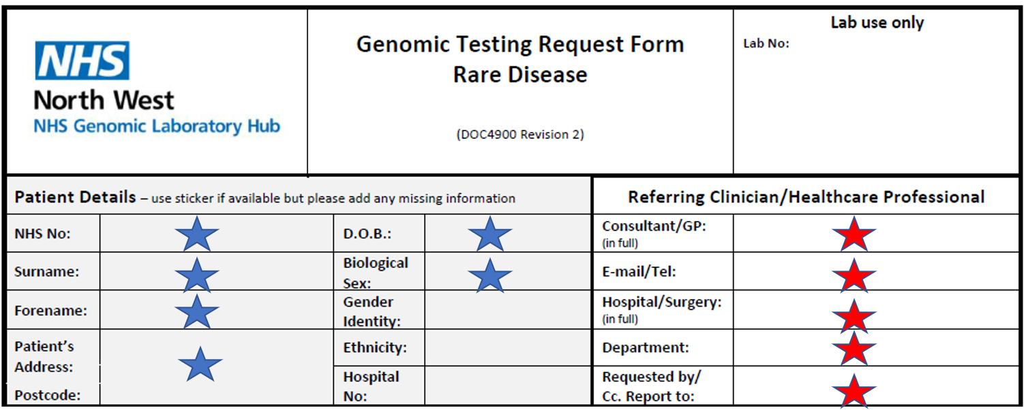

Minimum requirements
Notes:
You can use a patient sticker if you wish, however if the patient labels does not contain all the information highlighted by the blue star, this must be filled in by hand
You must also complete your information as the referring clinician. These must be included in full, so for example you must write out your full name and not just initials. . Hospital and department you are working in should be written in full, abbreviations should not be used.
You will need to provide an e-mail or telephone number for the lab to be able to get in touch with you in order to provide you with the result

Slide 8
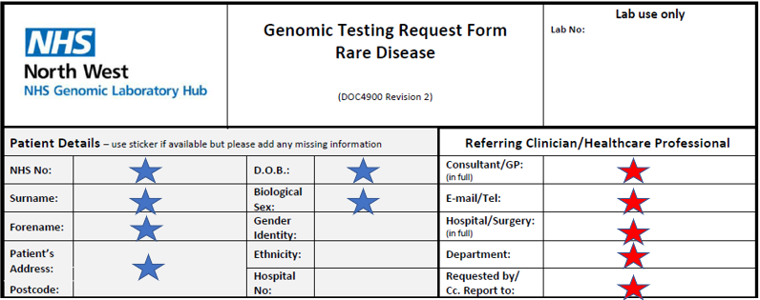
Specifying who the result should get sent to
Notes:
Finally, the last box. If it is not the patients consultant who is completing the form but you would like them to receive a copy of the report, you can put their details here

Slide 9
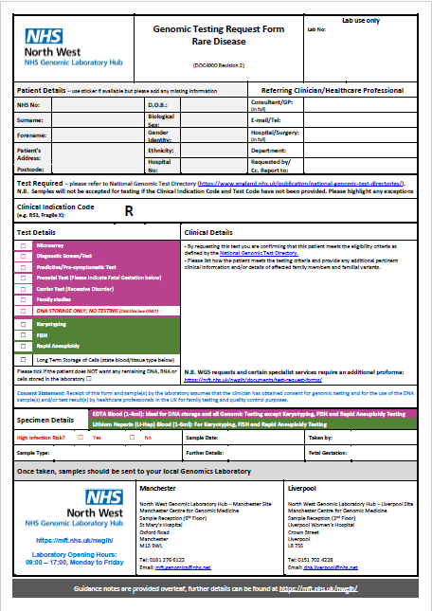
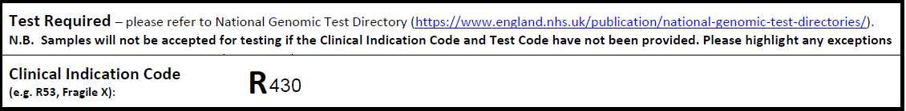
Test required
Pick the most relevant test based on the patient and family history
This will be:
R430, R444, or R240
Notes:
The section below that is where you put the test that is required
Every test in the National Test directory has a code. As has been previously outlined, the tests that you will requesting will either be R430 or R444. So, you write the number of the test you want to request in this section. What

Slide 10
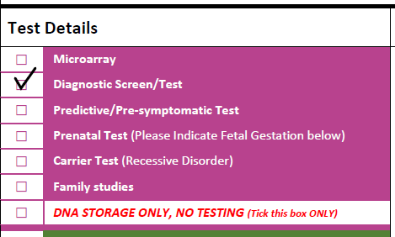
Test details
Notes:
The pink section on the form you specify the particular type of test you are doing. As you will be requesting a diagnostic test, you will need to either tick or mark an X in the diagnostic screen test box

Slide 11
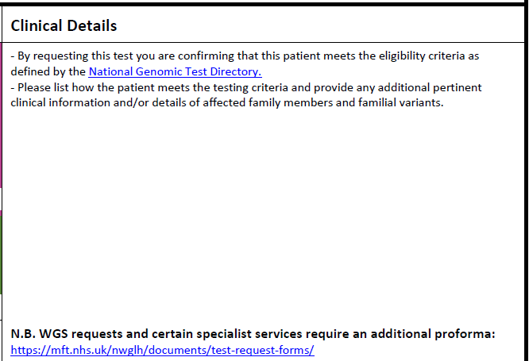
Clinical details
Patient diagnosed with prostate cancer under the age of 50
Notes:
To the right, is the clinical details section
Here is where you put how the patient meets testing criteria as specified in the national test directory. As we have previously stated, testing criteria can change when new versions of the test directory are released. It is therefore really important that you check the test directory before ordering a test

Slide 12

Option to not store DNA
Notes:
We have spoken about how it is usual practice for the lab to store a patients DNA. If your patient is happy for their DNA to be a stored, you don’t need to do anything. However, if the patient does not wish to have their DNA stored, you will need to tick this box

Slide 13
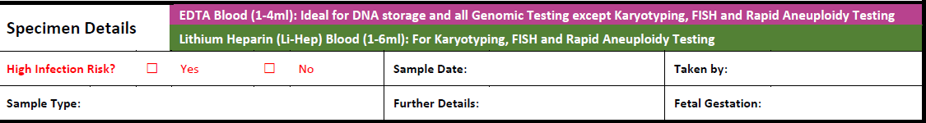
Specimen details
Notes:
The last section is to be completed by the person who takes the blood sample.
These are the specimen details so stating that it is an EDTA blood sample, when it was taken and who by.

Slide 14
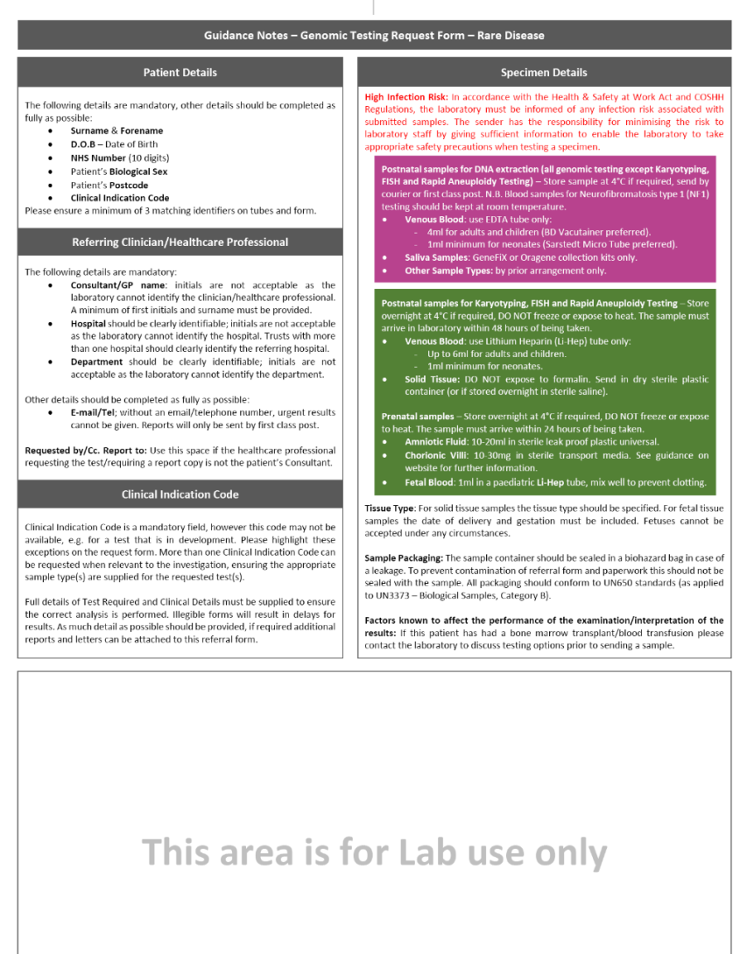
Second page
Nothing to complete on this page
Notes:
As previously stated, the second page does not need to be completed. It provides guidance on how to complete the test request form
So that’s completes the section on the test purpose and process
Thank you

