Slide 1
The Consent Conversation/Record of discussion for Germline Testing.
Claire Brooks, Registered Principal Genetic Counsellor, AHCS No 16940
Liverpool Centre for Genomic Medicine
The best people, giving the safest care, providing outstanding experiences

Slide 2
Overview
What is a record of discussion?
What should it include?
How is it completed and other considerations.
Other sources of information.
Notes:
NB:
Not everything included will need to be explained to every patient, as of course every patients needs are individual. However, we have tried to include information to equip you for the variety of questions you may be asked during the consent conversation and record of discussion process.

Slide 3
What is a record of discussion?
A way of structuring and recording the genetic test consent conversation.

Slide 4
What should it include?
The test purpose/conditions testing for.
The family implications
Uncertainty
Unexpected information
DNA storage
Health records
Notes:
We shall go through these in turn

Slide 5
The test purpose and conditions testing for.
Why the patient is being offered the test.
What the test is looking for and what it involves.
Implications for the patient
Limitations of the testing
Consequences of not having the testing.
Timing of test
Possible psychological implications of the result.
Notes:
2) This might be a discussion of the specific genes are on the test. What they are, what they do, or if it is a large panel of genes, a brief overview of them, for examples it includes a number of genes known to be involved in inherited prostate cancer
Blood test
3)Implications: this might include that the test result may influence the type of treatment offered, their medication or surgery options.
They also need to know, that The result may provide information about other cancers they could be at risk of. Or that they may then have further screening options or access to specific risk reducing surgery if something is found.
4)They need to know that if a variant is found, that it cant be “cured”. If don’t find a change, could still be inherited, it may just be that our technology has not been able to find the gene change at this time.
The results of genetic testing can take longer than some other tests. – need to know how long the results will take, who will give them their results, how they will be given and what to do if they have not received the results as expected.
5)What will be different about their care if they choose not to have the test?
6)Does the patient have to make a decision straight away? Could they go away and think about it further/discuss with wider family for whom there might also be implications if a pathogenic variant is found.
7) It can be quite a big thing to hear that you have a gene alteration which may have other implications increasing their chance of other cancers or health issues and that this might not only affect them as an individual but their wider family also. It can be emotional receiving genetic test results regardless of what the results shows. Sometimes patients describe being surprised by their feels surrounding the results. They feel different than they thought they would.. The important thing to remember is that there are no wrong feelings and that they allow themselves the time and space to express their feelings.

Slide 6
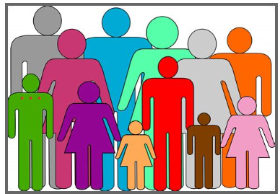
The family implications.
The results of the test may have implications for other family members.
Information may be needed to be passed on to help inform the care of other relatives
Notes:
If a disease-causing alteration is found, this may mean other members of the family also have a chance of having inherited the same gene change. This can feel quite daunting for some patients and they can often feel they are responsible for the condition in the family, if they are the first person it is found in.
It is good practice to encourage patients to inform their wider family they are having genetic testing, if they feel able. Family members often cope better with a result when they were prewarned that genetic testing was being undertaken.
If alteration found, other members of the family will be able to access testing to see if they have also inherited the gene change and access screening as appropriate. In clinical genetics we can help patients communicate this with the wider family using “Dear relative letters”. Letters they can pass on to their family which explains what has been found and how find out more, if this is something they wish to do.

Slide 7
Uncertainty.
Variants of uncertain significance.
Interpretation of results may change over time
Notes:
The results may not always be clear.
Genetics relatively new science and information and knowledge is changing all the time. We may know more in the future and the information we provide now may change in the future. The classification of a variant may change either upgrading or down grading classification as our knowledge increases. Similarly, what we know about the effects of having the gene change may alter. There may be other conditions that an individual may be at risk of, or screening recommendations for example may change.

Slide 8
Unexpected information.
Test may reveal information relevant to other diseases that are not related to why the test is being done.
Notes:
For example, there may be other conditions or potential health risks that are identified, which is not related to why the test is initially being done. These may be found by chance and may need further investigation to assess their significance. But if anything is found the patient will be informed about this and what it means for them. This is particularly relevant when the test includes a large panel of genes and therefore the clinician is unable to give all the specific information for each gene tested.

Slide 9
DNA storage
Normal laboratory practice is to store DNA extracted even after current testing is complete.
This Photo by Unknown Author is licensed under CC BY
Notes:
Can be used for quality control purposes in relation to lab equipment and as a control to test other relatives samples against if a disease-causing variant is found.
However, no other testing will occur on this sample without patients explicit consent.
If after discussion the patient doesn’t want their DNA stored, there is a box on blood request form, that must be ticked. Otherwise, the DNA will be automatically stored

Slide 10
Data storage.
Data from the test will be stored to allow for possible future interpretation

Slide 11
Health records.
Results from the test will form part of the patient health records.
This Photo by Unknown Author is licensed under CC BY-ND
Notes:
This will only be available to the relevant health care professionals.

Slide 12
How is it completed? Other elements to consider.
Digitally or by hand.
Is the patient sufficiently competent to make the decision?
Assess this based on the Mental Capacity Act 2005 and/or Gillick test (for individuals <16 years).
for patients who are non-English speaking, hearing impaired, visually impaired, or have additional learning needs, ensure that they have the resources or support available to allow them to participate fully in the consent discussion.
Notes:
Forms can be completed digitally or by hand. Some people choose to read through the form verbaitim, others paraphrase as the information becomes more familial to them. Go through each section ensuring that the patient understands and answering any questions they may have. In a remote consultation the clinician can complete on behalf of the patient and indicate that consent was given verbally.
2 – other considerations as with all consent: list

Slide 13
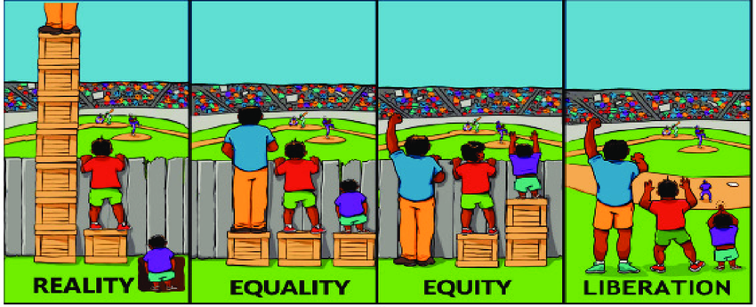
How is it completed? Other elements to consider.
Has the patient been given the appropriate amount of information to help them make a decision?
Assess individual information needs.
What do they know already?
Identify gaps
Continually check understanding.
Notes:
as mentioned at the beginning of the presentation, different patients will require different levels of information to get to them to a position where they feel able to make an informed decision. As with other consent, it is still required that the individual needs of each patient are assessed. Identifying, what they understand already, identifying gaps in their knowledge and checking understanding by allowing the patient to ask questions and asking them to repeat back what they have understood.

Slide 14
How is it completed? Other elements to consider.
Insurance
Patient information leaflet
Notes:
Link at the end of the presentation for further information regarding insurance and genetics.
Consider is there a patient information leaflet or other sources of information you can direct your patient to if they would like to read further after your appointment.

Slide 15
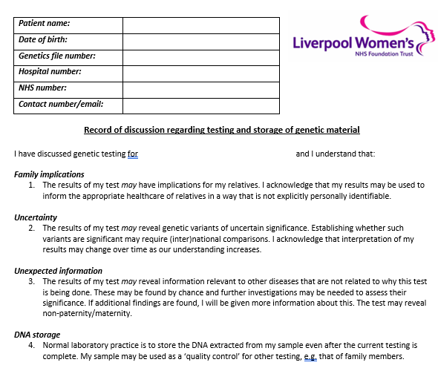
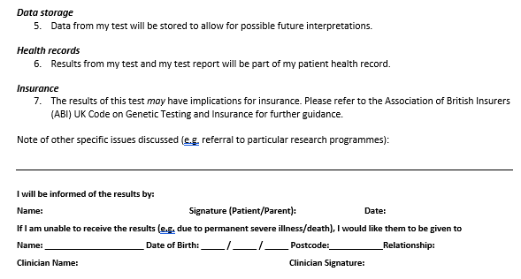
The record of discussion form
Notes:
This is an example of a record of discussion form. There are links to further examples that be edited for your own use at the end of this presentation. Most Genomics Laboratory Hubs will also have a copy of a record of discussion or consent form on their website also. The link to the North west laboratory hub form is also included at the end of this presentation.

Slide 16
Other sources of information?
For clinicians within Merseyside and Cheshire:
Email: lwft.clingen@nhs.net
Telephone: 0151 802 5008
Notes:
What to do if your patient has additional questions?
Happy to receive questions or help if further discussion is required for specific patients.

Slide 17
Other sources of information?
Insurance information:
https://www.abi.org.uk/data-and-recources/tools-and-recources/genetics/code-on-genetic-testing-and-insurance/
Joint Committee on Genomics in Medicine (2019)provides a comprehensive overview of the specific issues of consent and confidentiality in genomic practice
https://www.rcplondon.ac.uk/projects/outputs/consent-and-confidentiality-genomic-medicine

Slide 18
Other sources of information?
Genotes: How to complete a record of discussion form
https://www.genomicseducation.hee.nhs.uk/genotes/knowledge-hub/how-to-complete-a-record-of-discussion-form/
Genomics education programme: Competency framework the consent conversation.
https://www.genomicseducation.hee.nhs.uk/competency-frameworks/consent-framework/~consent-conversation
Northwest GHL Genomic test consent form
https://mft.nhs.uk/nwglh/documents/consent/

