Slide 1
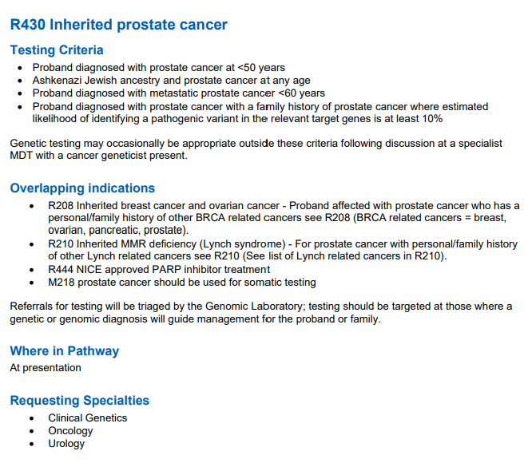


Germline testing
8 genes on R430: BRCA1, BRCA2, ATM, CHEK2, PALB2, MLH1, MSH2, MSH6
Notes:
Going back to the list of who is eligible for R430, the final bullet point is the more complex one.
This says: Proband diagnosed with prostate cancer with a family history of prostate cancer where estimated likelihood of identifying a pathogenic variant in the relevant target genes is at least 10%
So how do we determine the likelihood of there being a pathogenic variant in relevant target genes

Slide 2
Estimating the likelihood of identifying a pathogenic variant
Two tools to estimate the likelihood of identifying a pathogenic variant in the relevant target genes:
Manchester Scoring System
CanRisk

Slide 3
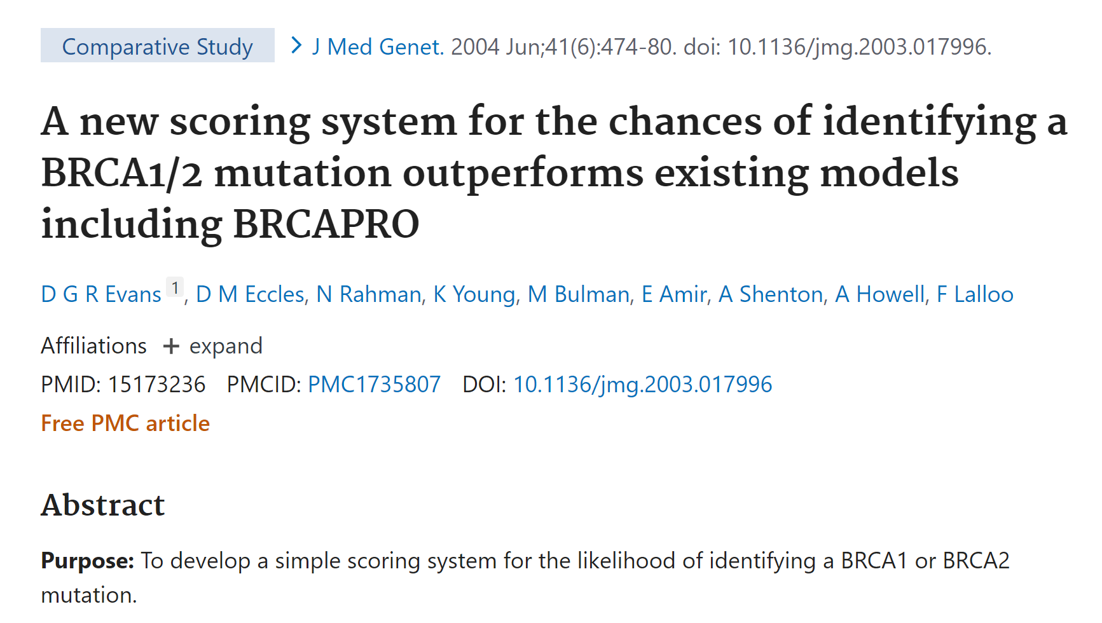
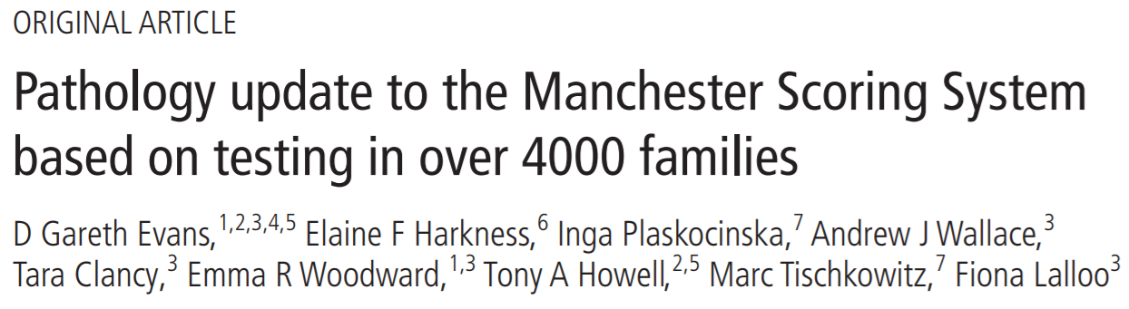
Manchester scoring system
Scoring system to determine the likelihood for identifying an BRCA1 or BRCA2 variant ONLY
https://pubmed.ncbi.nlm.nih.gov/15173236/
https://jmg.bmj.com/content/jmedgenet/54/10/674.full.pdf
Notes:
So what is a Manchester score?
It was a scoring system designed to be simple, to identify the likelihood for identifying an BRCA1 or BRCA2 mutation
Terminology we now use is ‘pathogenic variant’ rather than mutation but both mean the same thing
An update to the MSS was publish that takes into account pathology info about cancers in the scoring

Slide 4
Guidance for combined Manchester Score
There is an information sheet by Greater Manchester Genomics to guide non-genetic specialists to calculate a Manchester Score for patients with cancer.
Patients with a Manchester Score ≥ 15 are eligible for R430 testing
15
Please see clinician pack
Notes:
There is an information sheet produced by the Greater Manchester Cancer Genomics to guide non-genetic specialists to calculate a Manchester Score for patients with a new diagnosis of cancer.
A MSS of 15 or more signifies a 10% or greater likelihood of identifying an alteration in the BRCA1/2 gene
So Patients with a Manchester Score ≥ 15 are eligible for R430 testing

Slide 5
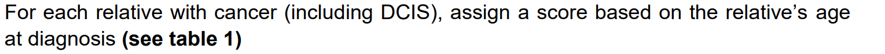
Calculating the Manchester Score
How to calculate the Manchester Score?
PART ONE – reviewing the patient’s family history
Only these cancers count in Manchester Scoring
Breast
Ovarian
Prostate
Pancreas
Notes:
MSS Requires you to score the family based on the numbers of cancer in the family, types of cancers in and the age at which they occurred
The scoring system can include DCIS
Only the following cancers count in MSS: breast, ovarian, prostate, pancreatic

Slide 6
Calculating the Manchester Score
How to calculate the Manchester Score?
PART ONE – reviewing the patient’s family history
To use the Manchester Scoring System you need to know
If any relative has had cancer
What type
Age at diagnosis
WHICH SIDE OF THE FAMILY they were on
Assess mum and dad’s side separately – do not add scores together for mum and dad’s side
Include your patient in both assessments

Slide 7
Father’s side, inc patient and sibs etc
Notes:
This is an e.g. of a paternal family history that could be counted up together, consisting of:
-pt
-their siblings
-pts father
-fathers siblings
-fathers parents

Slide 8
Mother’s side, inc patient and sibs etc
Notes:
This is an e.g. of a maternal family history that could be counted up together, consisting of:
-pt
-their siblings
-pts mother
-her siblings
-her parents
-any cousins

Slide 9
Family history question ideas
Your family tree may alter what testing we can offer. Has anyone else in the family had breast/pancreatic/
prostate/bowel cancer?
Clear intro and first question
Gentle questioning not interrogation
Explaining terminology
Clarifying specifics
Summarise details given
Final open question
How are you related? How old do you think they were when it was diagnosed?
Is she a full sister, so same mum and same dad?
So your cousin Jane is your dad’s sister’s daughter?
So let me check all that: your mum had breast cancer at 52, her mum, your grandmother, had ovarian cancer at 86, is that right?
Has anyone else had a cancer that we’ve not talked about yet? Is there anything else you think I should know?
Acknowledge/thank patient for sharing
Notes:
Gently investigate, rather than interrogate, why should they know that age their grandfather’s sister had a cancer? Your tone will affect the rapport, instead of how old were they? Consider ‘would you know how old she was then it was diagnosed? Roughly?’
Terminology, don’t’ assume people know what a sibling is, or a half brother/sister. Reiterate your meaning
Summarise what is recorded, a patient may mishear a question, or give the wrong information if they feel forgetful or flustered. This allows for that to be corrected.
Here are some ideas of questions to ask in order to quickly get further details on the family
Your family tree may alter what testing we can offer. Has anyone else in the family had a breast cancer, prostate?
How are you related? How old do you think they were when it was diagnosed? If unsure, can gently ask were they an old person when dx, or particularly young? would you know how old she was then it was diagnosed? Roughly?
Important to Clarify information e.g. – full sister? Same mum and dad? Cousin through mum or dad? Aunt or great aunt

Slide 10
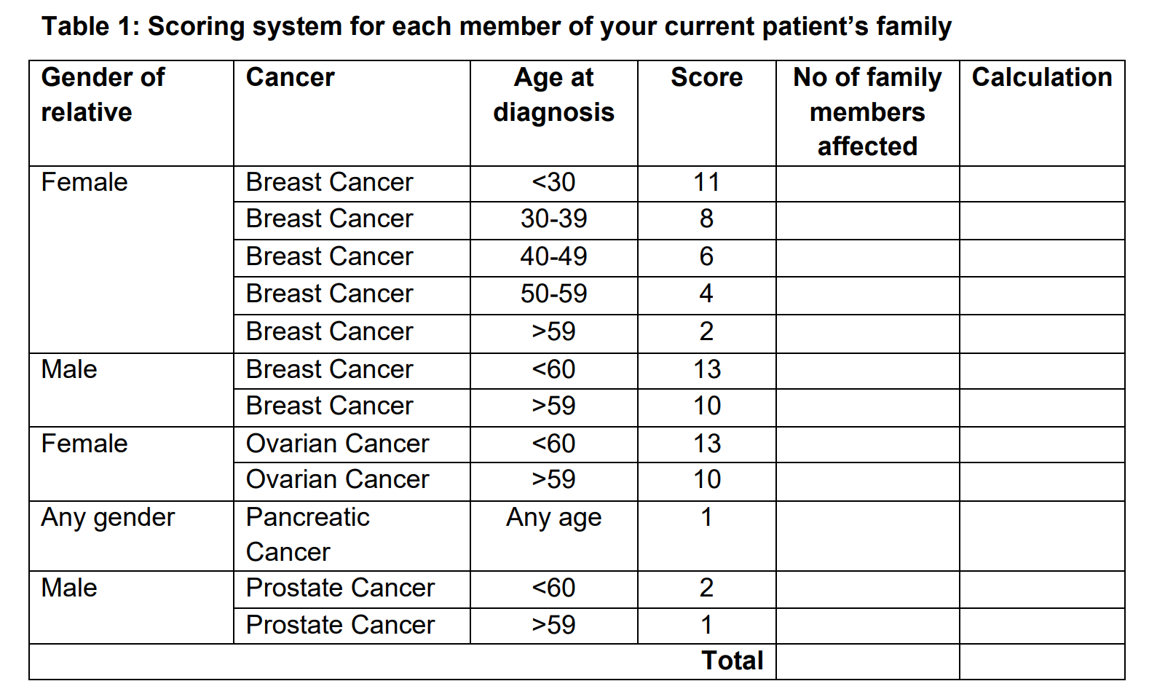
Guidance for combined Manchester Score
15
Total determines eligibility for R430
Notes:
Once clarified who has had cancer, can use this scoring system to assign and calculate points
Once you’ve done a score for the father and mothers side of the family, chose the side with the highest score
MSS requires that you ONLY modify for your patients current cancer. The MSS only does pathology adjustments for breast cancer. As your patients will have prostate cancer, you don’t need to worry about adjustments
The final score will determine eligibility for R430 testing
Another relative could potentially be eligible for testing even if your patient is not

Slide 11
Family A
Your patient is male with prostate cancer aged 60
Her mother had breast cancer aged 51
Mother’s sister had breast cancer at 61

Slide 12
Family A
Your patient is male with prostate cancer aged 60
HIS mother had breast cancer aged 51
Mother’s sister had breast cancer at 61
Do not
offer
R430
1
4
1
2
1
1
7
Notes:
7 – NOT ELIGIBLE FOR R430

Slide 13
Family B
Your patient is male with prostate cancer aged 47
His brother had prostate cancer aged 50
His mother had ovarian cancer aged 62
His mother’s brother had prostate cancer aged 60

Slide 14
Family B
Your patient is male with prostate cancer aged 47
His brother had prostate cancer aged 50
His mother had ovarian cancer aged 62
His mother’s brother had prostate cancer aged 60
Offer
R430
1
10
2
4
1
1
15

Slide 15
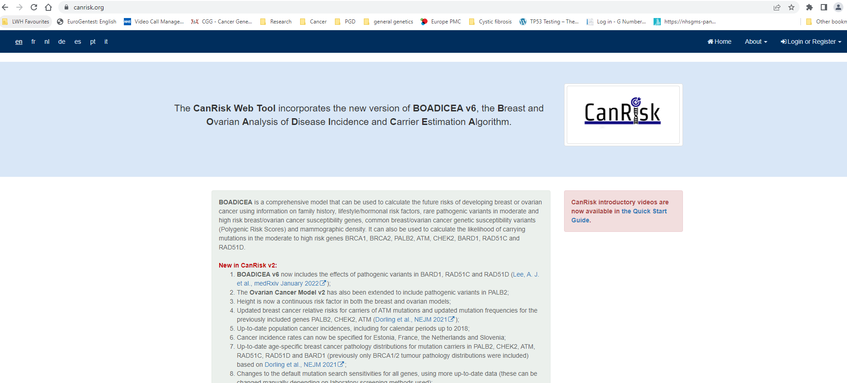
CanRisk
Notes:
The other tool we can use to estimate the likelihood of identifying a pathogenic variant in the relevant target genes is Canrisk

Slide 16
CanRisk
Personalised breast/ovarian cancer risk assessments
Calculates ‘mutation probability’ (the likelihood of finding a variant) for several genes
NHS approved
Can include:
Family history of cancers
Tumour details
Genetic testing results
Lifestyle risk modifiers including BMI, Alcohol use
Notes:
Canrisk calculates Personalised breast/ovarian cancer risk assessments
Calculates ‘mutation probability’ of several genes – the likelihood of finding a variant in one of those genes
NHS approved
For female patients it will take into account various factors in it’s risk assessment
For male patients, it is much more straightforward

Slide 17
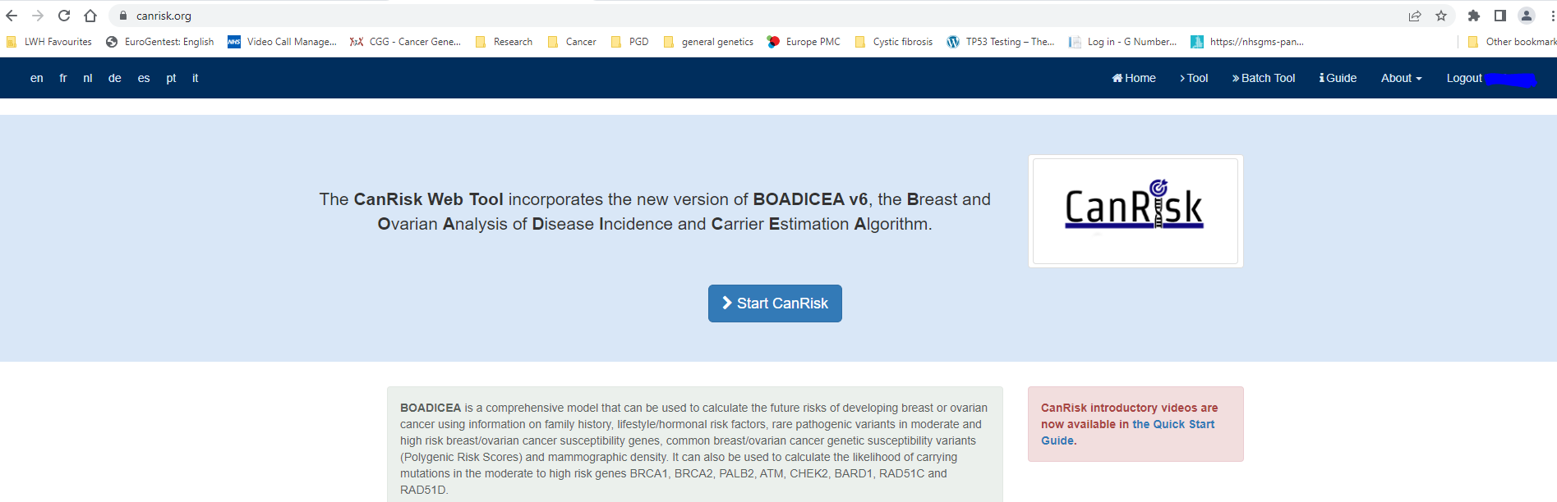
Notes:
You can access it online (canrisk.org)
And you do need to register to use it but registration is free and simple
Once registered and logged in you can start CanRisk

Slide 18
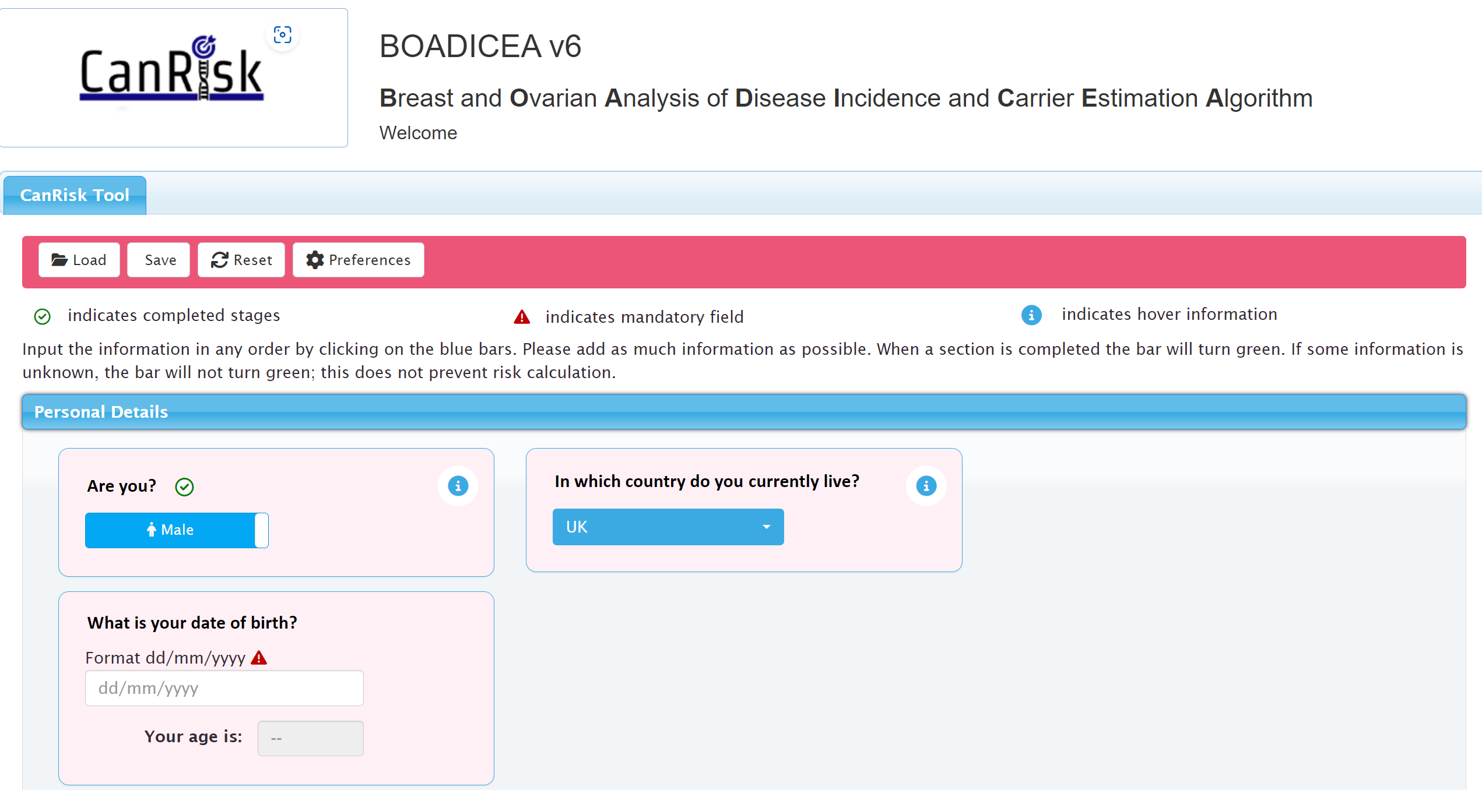
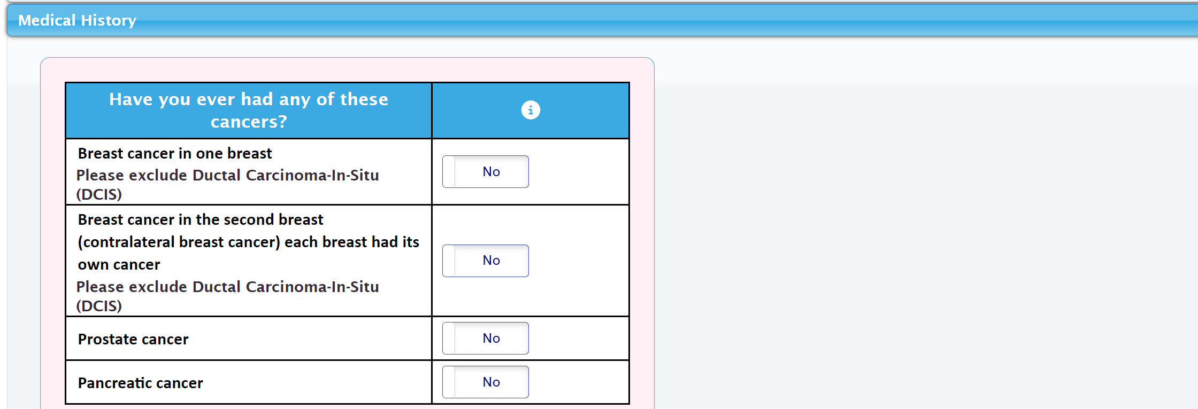
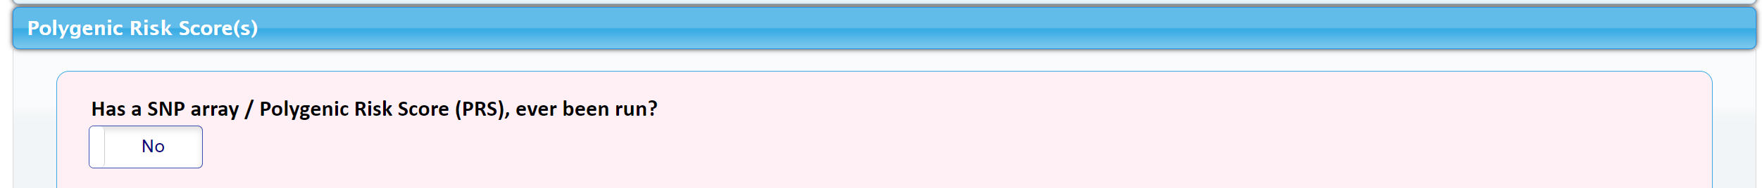
Notes:
Enter patient information and follow through tabs
For male patients Canrisk asks for DOB, whether patient ever dx breast prostate or pancreatic cancer
Much more asked if female patient

Slide 19
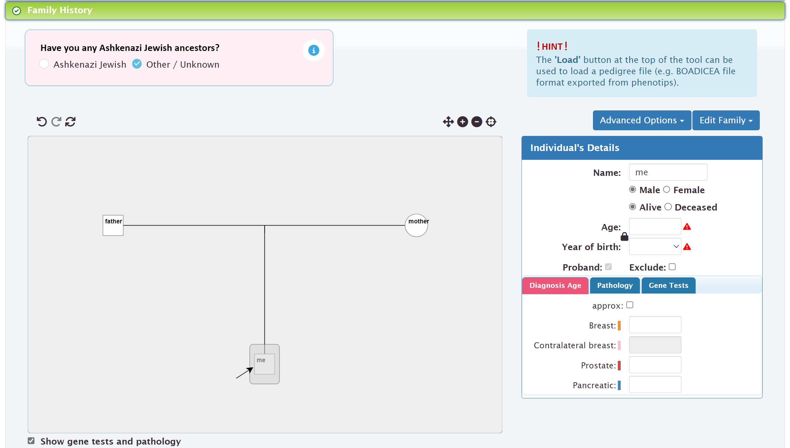
Notes:
You can also add family history information including
a patients relatives
Ages
Whether living/deceased
Their cancer dx and age at dx
Pathologies – if you have them
Any genetic test results you might have
Whether AK Jewish ancestry
Its important to include relatives who have not had cancer too!

Slide 20
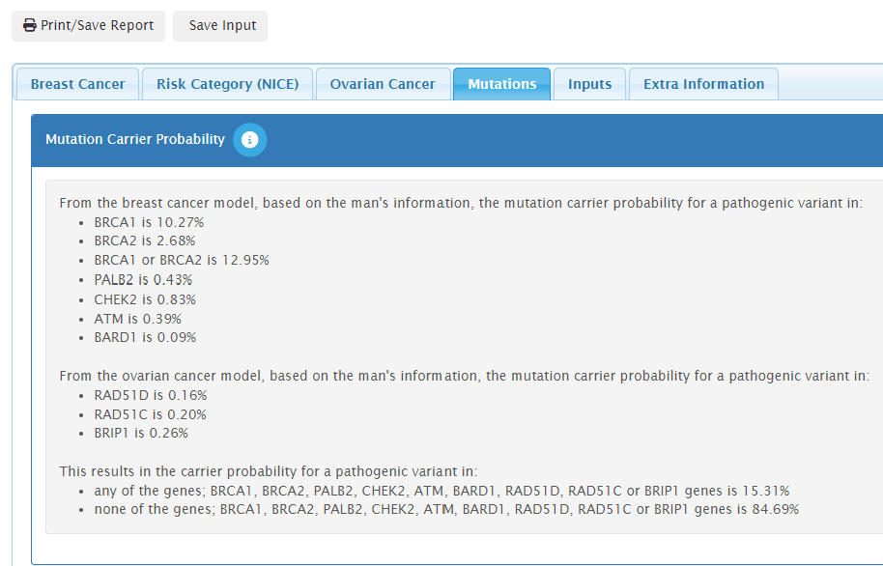
Estimating the likelihood of identifying a pathogenic variant
Likelihood ≥10%: offer R430
Lynch-syndrome gene mutation probability NOT calculated in CanRisk (MLH1, MSH2, MSH6)
Notes:
If estimates likelihood of identifying patho variant in relevant genes is >10% for the genes involved in R430 then that pt is eligible for R430 genetic testing
This an e.g. of a mtn caluculation
It lists different genes
Add up scores for the genes on R430 which currently are: atm brca1 brca2 chek2 palb2
Lynch genes not on Canrisk

Slide 21
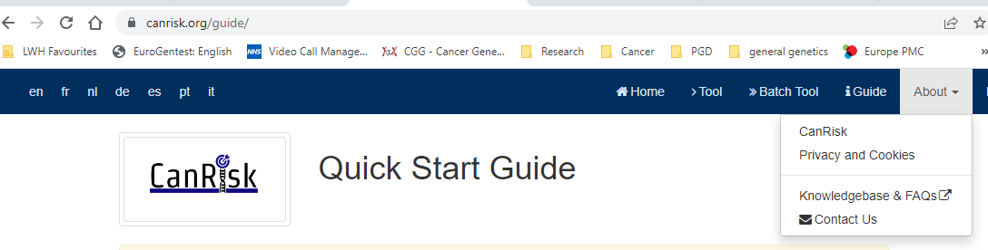
CanRisk
Video user guides available online
https://canrisk.org/guide/
Also guide with FAQs, via About tab
Notes:
Video user guides and faqs under the about tab

Slide 22
R430 eligibility: points to consider
Refer to Genomic Medicine if:
family history is unclear, complex or needs confirming
unusual cancers in the family
genetic alteration already known in the family (include details)
Notes:
If patient vague re family hx and not eligible for testing in own right e.g. prostate under 50
May need to be referred to LCGM for us to confirm details
If aware that genetic predisposition to developing cancer already found in family and pt part of family and not had test
Can refer to us, with details of genetic testing done in family if that means we can offer pred testing for known familial variant
Manchester score and Canrisk have their limitations

Slide 23
Other cancers to look out for
Other prostate cancers
Breast cancer
Ovarian cancer
Pancreatic cancer
Lynch-syndrome related cancers
  colorectal cancer, endometrial cancer, ureteric cancer, transitional cell cancer of renal pelvis, cholangiocarcinoma, small bowel cancer, glioblastoma, endocervical cancer, multiple sebaceous tumours, gastric cancer.

Slide 24
Summary
Somatic testing is available for all metastatic castrate resistant prostate cancers
If patient eligible for somatic testing but it’s not possible, offer germline testing (R444)
Some patients eligible for germline testing ‘R430 Inherited Prostate Cancer’ due to age at diagnosis, having Ashkenazi Jewish ancestry, metastatic disease, or due to their family history
Refer to Genomic Medicine if germline variant identified
Where germline variant isn’t identified but patient has significant family history (prostate, breast, ovarian, or pancreatic cancer, or Lynch syndrome-related cancers) please refer to consider further testing opportunities
Notes:
To summarise
Somatic testing for all metastatic castrate resistant prostate cancers
If patient eligible for somatic testing but it’s not possible, offer germline testing (R444)

Slide 25
Contact details
Please email queries to:
lwft.clingen@nhs.net
Or call
0151 802 5008
Thanks for listening

