Slide 1



Assessing Eligibility and Selecting the Correct Test
Inherited prostate cancer genomic testing
Sarah Maguire, HCPC Registered Genetic Counsellor
Liverpool Centre for Genomic Medicine
The best people, giving the safest care, providing outstanding experiences

Slide 2

Overview
  Relevant genomic tests
    Somatic
    Germline
  Genomic Test Directory eligibility criteria
  Assessing eligibility for testing
  Choosing the right test
  When to refer onward

Slide 3
Germline vs somatic testing
Germline variant
-‘Constitutional’ variant
-Present in germ cells (egg and sperm)
-Can be passed on to offspring
Somatic variants
-All the other cells of the body
-Changes to the DNA of somatic cells
-Occur in a single body cell initially: only tissues derived from original altered cell are affected
-Cannot be inherited
Most cancers are a result of somatic variants that have accumulated in the cancer genome (but are not present in all cells of the body)
Small portion of all cancers are driven by an underlying germline variant in a cancer predisposition gene.
Notes:
Our body contains two major cell types, the germ cells (sex cells) which are the egg and sperm.
These cells pass on their genome from one generation to the next
All other cells of the body are known as somatic cells
An alteration in the germline can impact the individual carrying the mutation, and can also be inherited by offspring and effect them.
Somatic mutations can impact the individual carrying the mutation, but cannot be passed on and have no effect on the offspring.

Slide 4
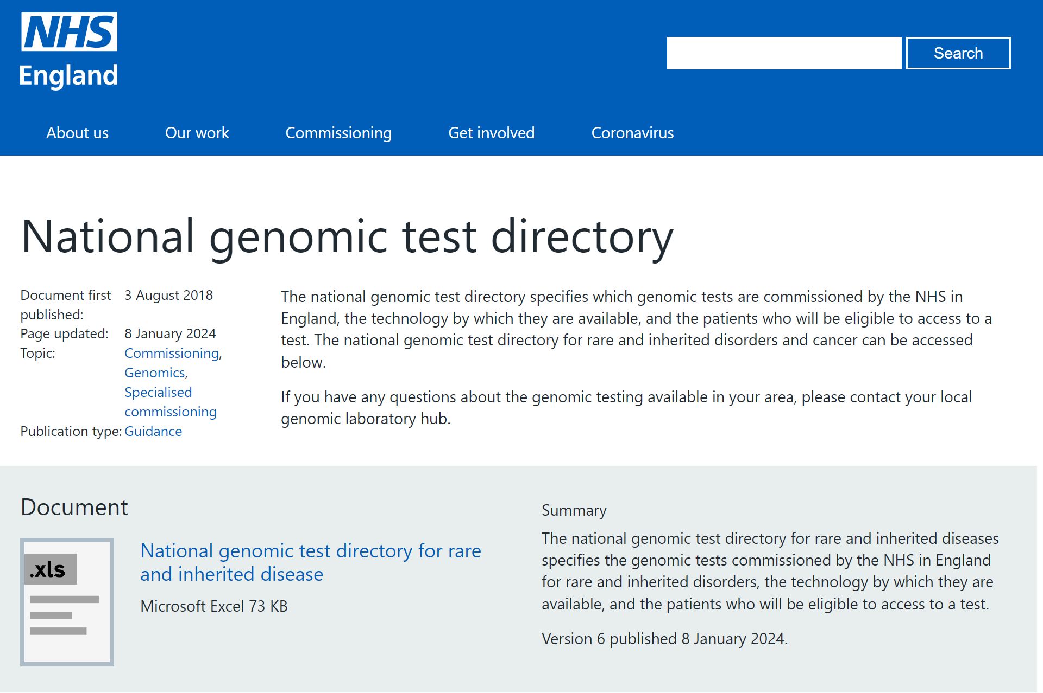
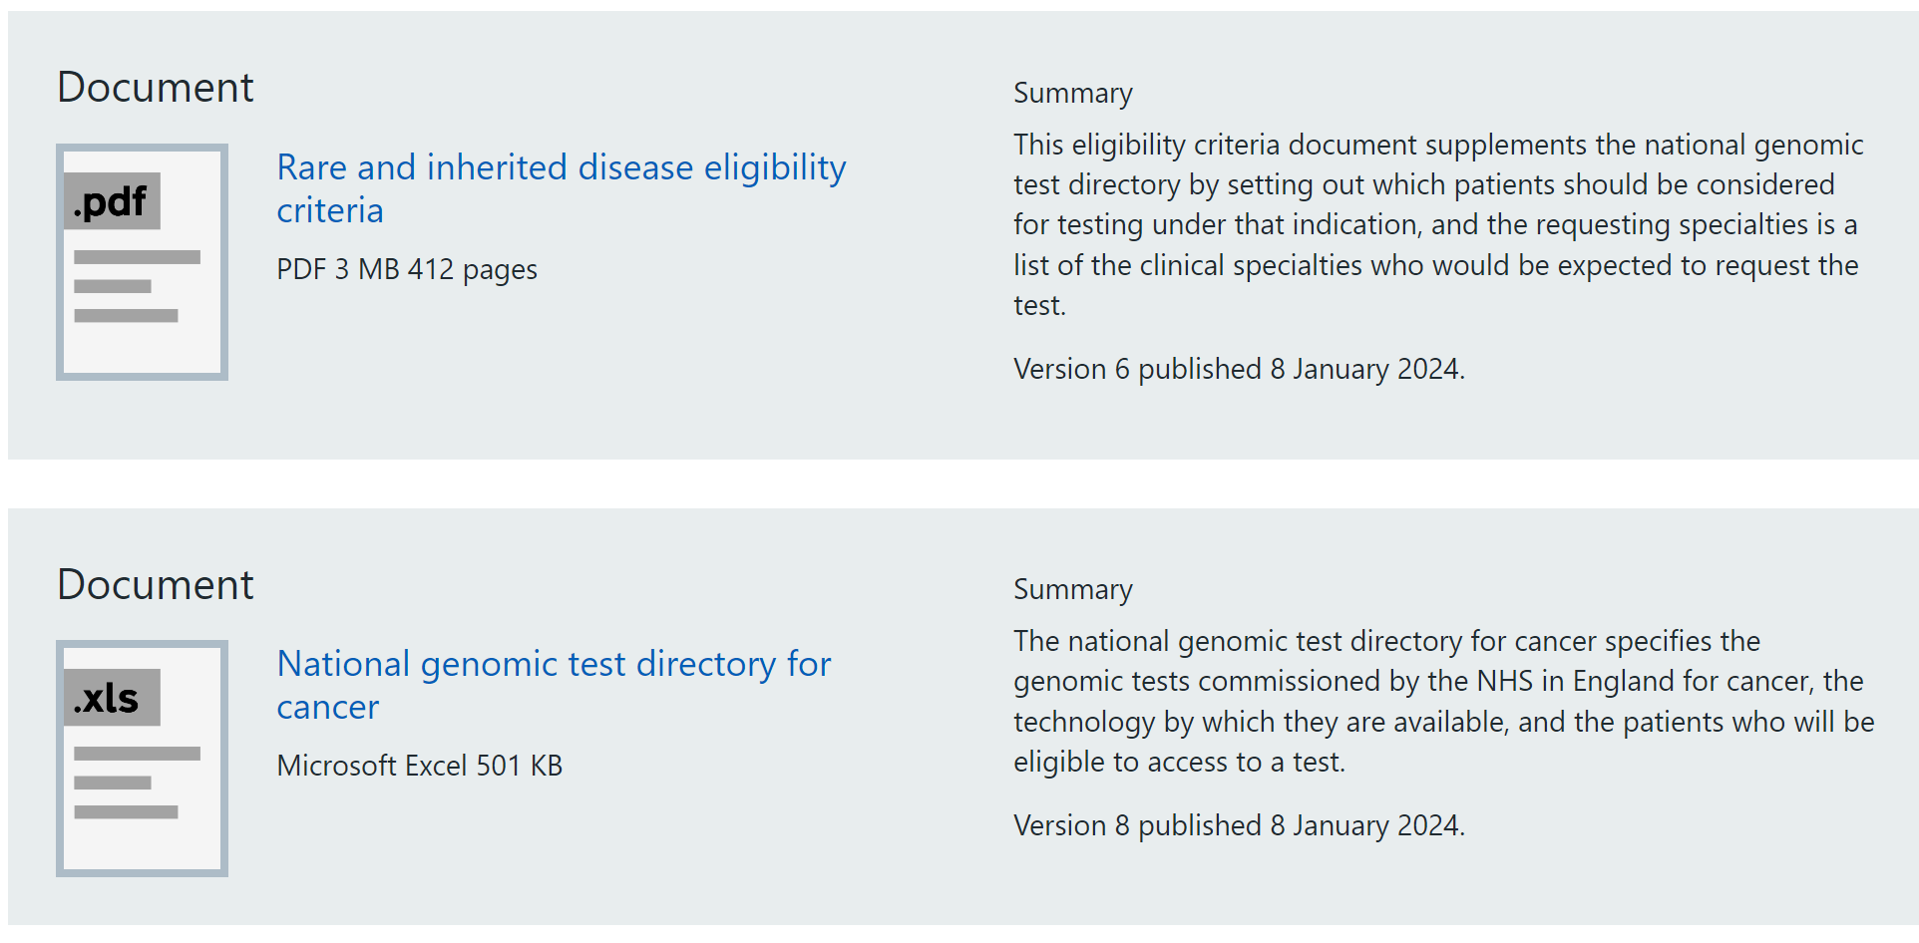
The Genomic Test Directory
https://www.england.nhs.uk/publication/national-genomic-test-directories/

Slide 5
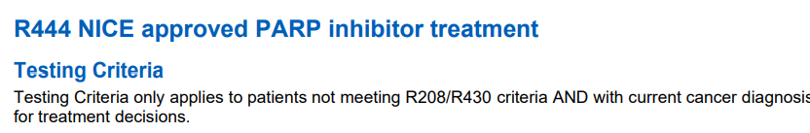
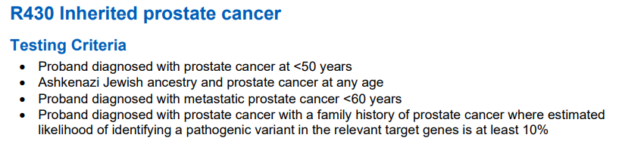
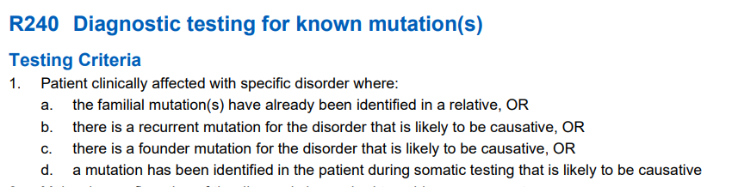
Germline tests
Somatic test
M218 somatic (tumour) testing
Notes:
Main R codes to be aware of
Another code to be aware of is M218

Slide 6
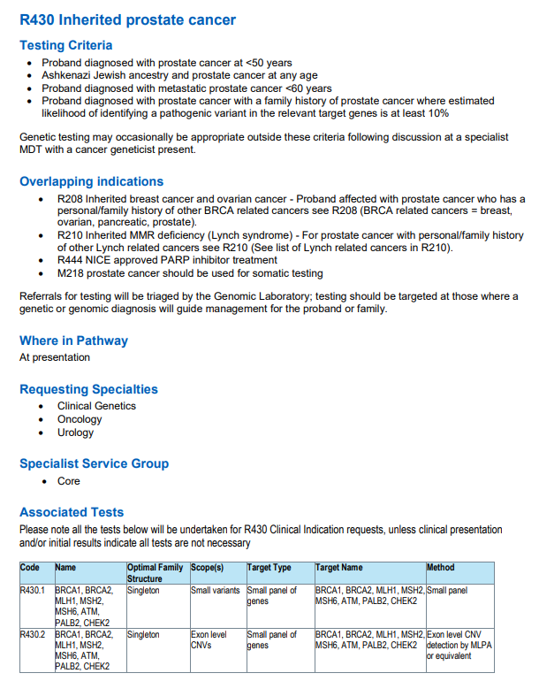
Consider if more applicable.

Slide 7
M218 Somatic (tumour) testing
Eligibility:
Patient has metastatic castration-resistant prostate cancer
Identification of patients that would benefit from PARP inhibitors
Should be attempted first, germline analysis should only be performed if there’s insufficient tissue or somatic analysis failed
TAT 21 days
Currently screens for BRCA1, BRCA2 per National Genomic Test Directory for Cancer
Likely pathogenic and pathogenic variants reported
Variants of Uncertain Significance (VUS) not reported
Notes:
Looking for genomic variants in DNAS extracted from tumour tissue
TAT 21 days
Currently screens for BRCA1, BRCA2 per the National Genomic Test Directory for Cancer
Likely pathogenic and pathogenic variants reported
Variants of Uncertain Significance (VUS) not reported but the we data/interpretation is saved in the case of future change in classification

Slide 8
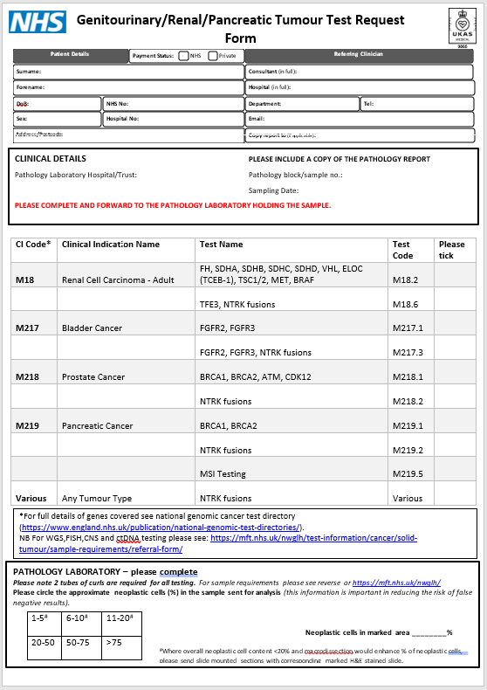
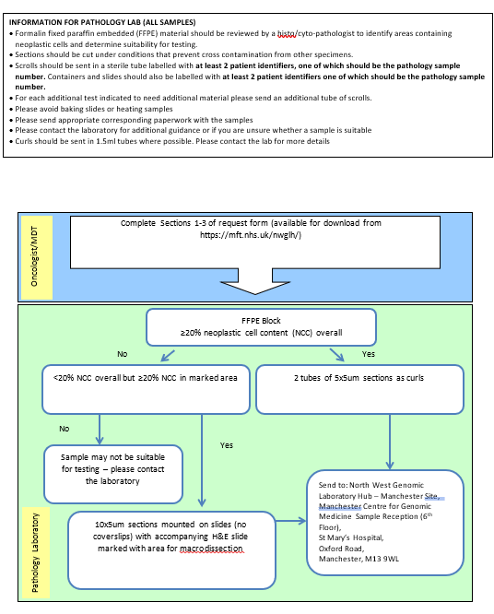
Somatic test request form

Slide 9
Patient identification & consent for test
FFPE sample sent to GLH for somatic (tumour) testing M218
Notes:
At present, you order somatic testing (also known as tumour testing) on all metastatic, castrate resistant prostate cancers
The main purpose of this is to identify those individuals with a BRCA1 or BRCA2 variant who would be eligible for treatment with PARP inhibitors

Slide 10

Patient identification & consent for test
Test code
FFPE sample sent to GLH for somatic (tumour) testing M218
M218 somatic (tumour) testing
BRCA1/2 normal
Report to Oncology
GLH=Genomic Laboratory Hub; FFPE = Formalin-Fixed Paraffin-Embedded tissue specimens
Notes:
At present, you order somatic testing (also known as tumour testing) on all metastatic, castrate resistant prostate cancers
The main purpose of this is to identify those individuals with a BRCA1 or BRCA2 variant who would be eligible for treatment with PARP inhibitors

Slide 11
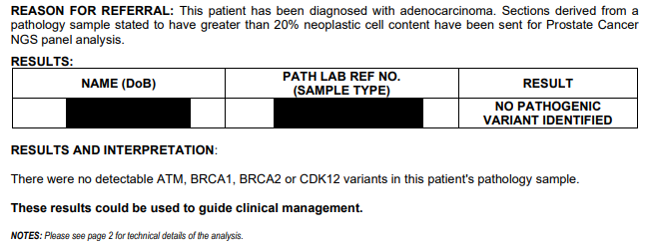
Somatic (tumour) testing
Uninformative report

Slide 12
Patient identification & consent for test
FFPE sample sent to GLH for somatic (tumour) testing M218
BRCA1/2 LP/P variant detected
Report to Oncology
Treat with Olaparib if suitable
Request germline testing & send bloods to GLH for R240
Test code
BRCA1/2 variant absent in germline
BRCA1/2 variant present in germline
Report to Oncology
Report to Oncology
Refer to Clinical Genetics for management & cascade testing
LP/P = Likely pathogenic / Pathogenic
Notes:
At present, you order somatic testing (also known as tumour testing) on all metastatic, castrate resistant prostate cancers
The main purpose of this is to identify those individuals with a BRCA1 or BRCA2 variant who would be eligible for treatment with PARP inhibitors

Slide 13
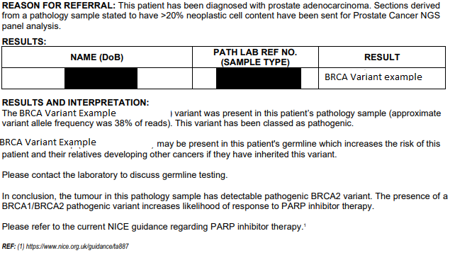
Somatic (tumour) testing
Variant identified report
Request germline testing R240
Notes:
Here is an e.g. of a somatic report in which a variant has been identified
Results and interpretation are self explanatory

Slide 14

Patient identification & consent for test
Low neoplastic cell content or no / inadequate tissue available
FFPE sample sent to GLH for somatic (tumour) testing M218
Sample fail
Test code
Report to Oncology and request germline R444 testing. Send blood sample to GLH
Fail
BRCA1/2 LP/P variant detected
BRCA1/2 normal
BRCA1 and BRCA2 ONLY
Report to
Oncology
Report to Oncology
Report to
Oncology
Caveat: only germline variants analysed
Offer to repeat
Treat with Olaparib if suitable
Refer to Clinical Genetics for management & cascade testing
LP/P = Likely pathogenic / Pathogenic

Slide 15
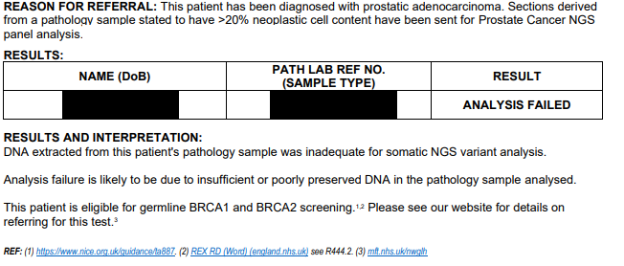
Somatic (tumour) testing
Analysis failed report
Request germline R444 testing.

Slide 16
Patient identification & consent for test
Low neoplastic cell content or no / inadequate tissue available
FFPE sample sent to GLH for somatic (tumour) testing M218
Sample fail
BRCA1/2 normal
BRCA1/2 LP/P variant detected
Report to Oncology
Report to Oncology and request germline R444 testing. Send blood sample to GLH
Report to Oncology
Any family history?
Discuss with Clinical Genetics
Treat with Olaparib if suitable
Request germline testing & send bloods to GLH for R240
Fail
BRCA1/2 LP/P variant detected
BRCA1/2 normal
BRCA1/2 variant absent in germline
BRCA1/2 variant present in germline
Report to
Oncology
Report to Oncology
Report to
Oncology
Caveat: only germline variants analysed
Report to Oncology
Report to Oncology
Any family history?
Discuss with Clinical Genetics
Offer to repeat
Refer to Clinical Genetics for management & cascade testing
Treat with Olaparib if suitable
Refer to Clinical Genetics for management & cascade testing

Slide 17
Germline testing for inherited prostate cancer

Slide 18
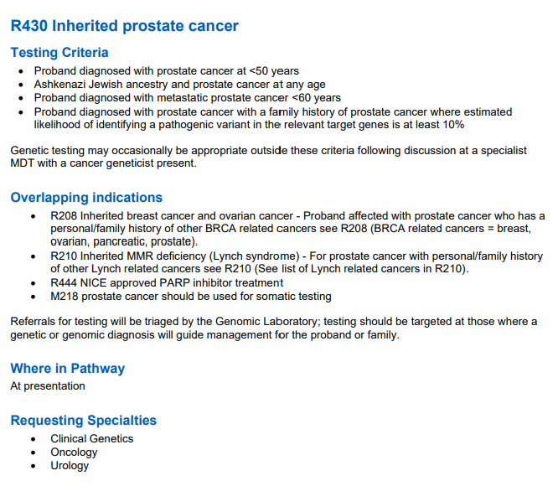
Germline testing
8 genes: BRCA1, BRCA2, ATM, CHEK2, PALB2, MLH1, MSH2, MSH6
Notes:
Germline testing for inherited prostate cancer is given the code R430
The test contains 8 genes
Testing criteria outlines in what instances this test can be offered
Let’s look at the first three bullet points first

Slide 19
Germline testing
Some patients will be eligible for both somatic and germline testing
e.g. male diagnosed with :
metastatic castration resistant prostate cancer diagnosed <50
Somatic testing for BRCA1 and BRCA2 (M218)
Germline testing for BRCA1, BRCA2, ATM, CHEK2, PALB2, MLH1, MSH2, MSH6 (R430)
Notes:
Bear in mind that a pt with met cat res prostate ca eligible for somatic and germline testing.
Reasonable to get somatic underway as well as germline
Likely to get somatic result quicker

Slide 20

R430 eligibility – own diagnosis (male)
‘What age were you first diagnosed with cancer?’
‘Are you aware of any Ashkenazi Jewish ancestry in your family?’
Is this a metastatic cancer?
Notes:
One of the eligibility is prostate cancer panel is dx prostate cancer <50y
A patient is eligible if Ashkenazi Jewish ancestry and prostate cancer at any age – if you don’t know if someone has AK Jewish ancestry, I usually say: ‘Are you aware of any Ashkenazi Jewish ancestry in your family?’
Or they were diagnosed with metastatic prostate cancer under the age of 60

Slide 21
Germline testing
8 genes on R430: BRCA1, BRCA2, ATM, CHEK2, PALB2, MLH1, MSH2, MSH6
Notes:
Going back to the list of who is eligible for R430, the final bullet point is the more complex one.
This says: Proband diagnosed with prostate cancer with a family history of prostate cancer where estimated likelihood of identifying a pathogenic variant in the relevant target genes is at least 10%
So how do we determine the likelihood of there being a pathogenic variant in relevant target genes

