Slide 1
Mainstream Genomic Testing for Inherited Prostate Cancer
Introduction to Genetic Testing
Anna Whaite, Registered Genetic Counsellor, GCRB 229
Liverpool Centre for Genomic Medicine
The best people, giving the safest care, providing outstanding experiences

Slide 2
Overview
Genes/chromosomes and DNA
Terminology:
Genetics vs genomics
Cancer and genetics
Pathogenic variants and penetrance
Germline and sporadic variants
What genes
What next
The future

Slide 3
Notes:
Source https://www.genomicseducation.hee.nhs.uk/image-library/ accessed 05.12.22

Slide 4
Notes:
Source https://www.genomicseducation.hee.nhs.uk/image-library/ accessed 05.12.22

Slide 6
Notes:
We use the term variant to describe versions of a gene. Some variants are harmful, ‘pathogenic’, others are harmless, ‘benign’. Some have uncertain significance, VUS – variants of uncertain significance.

Slide 7
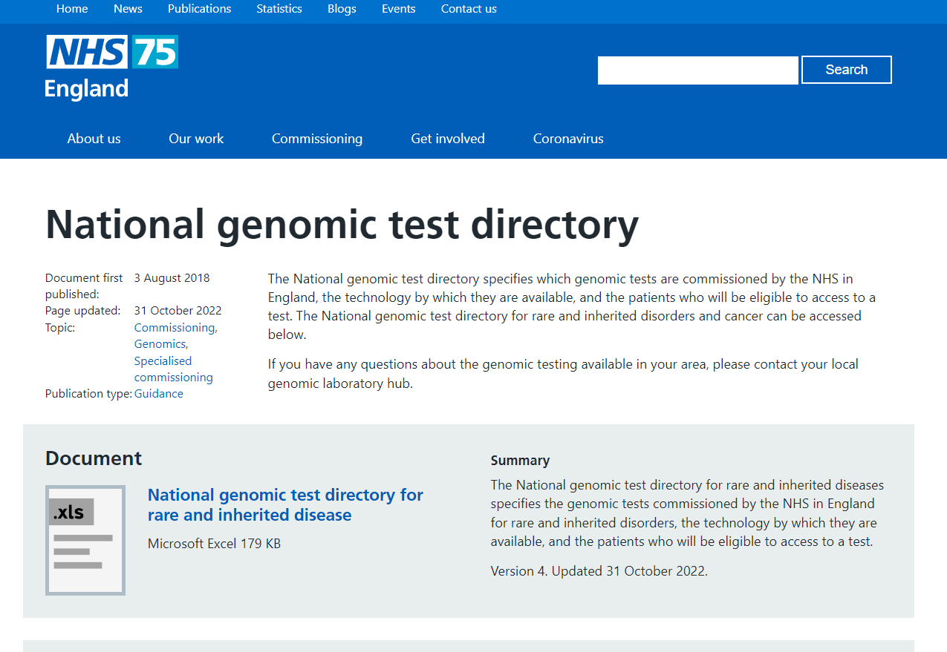
The Genomic Test Directory
https://www.england.nhs.uk/publication/national-genomic-test-directories/

Slide 8
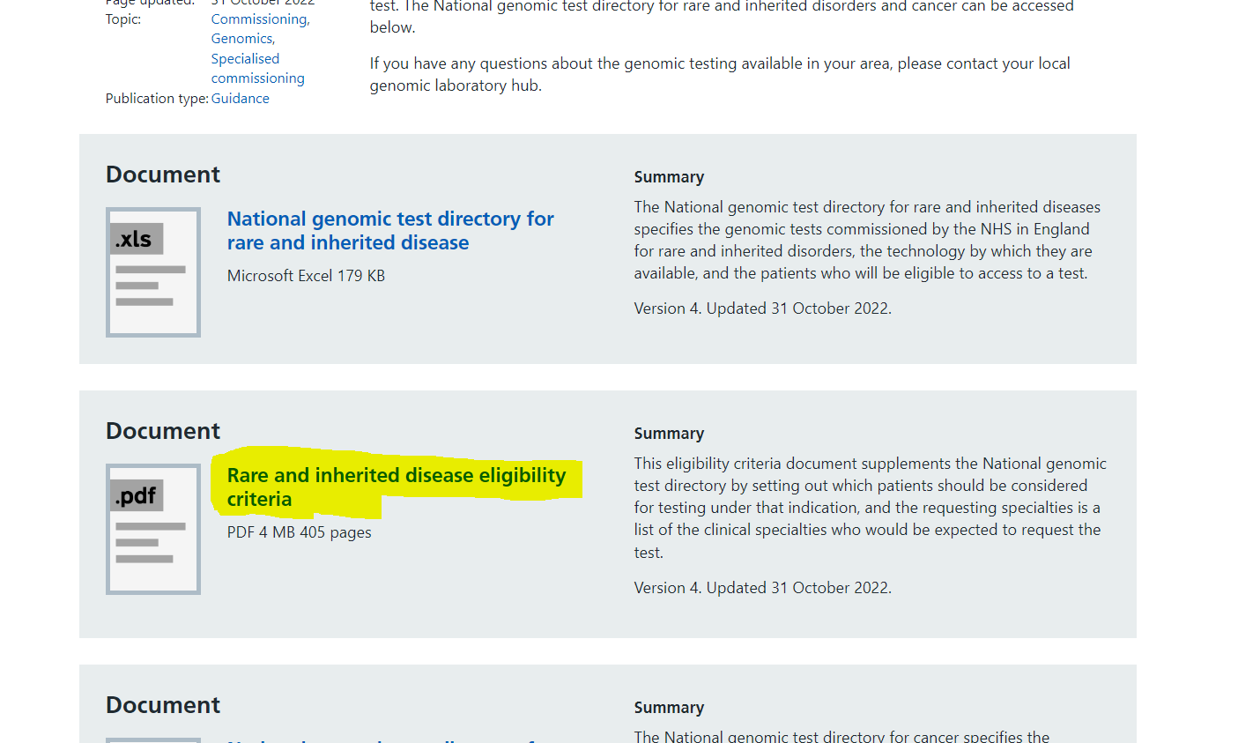
Notes:
https://www.england.nhs.uk/publication/national-genomic-test-directories/
My highlighting – this is the link for the eligibility PDF document, updated 3 times in 2022

Slide 9
What genes are relevant?
R430 inherited prostate cancer genomic testing currently reports pathogenic variants in
BRCA1
BRCA2
PALB2
CHEK2
ATM
MLH1
MSH2
MSH6
R444 tests BRCA1 and BRCA2
Somatic testing can include BRCA1, BRCA2, ATM and CDK12
Lists of genes is likely to expand further

Slide 10
What genes are relevant?
BRCA1 and BRCA2
High risk of breast/ovarian cancer in women
PALB2
High risk of breast/ovarian cancer* in women
CHEK2 or ATM
Typically moderate risk of breast cancer, some variation, needs family history assessment
Is one ‘very high risk’ ATM variant
MLH1, MSH2, MSH6, PMS2*
Lynch syndrome genes
Increased risk of colorectal and endometrial plus others such as prostate ovarian, gastric, renal pelvis, ureter, small bowel, glioblastoma, multiple sebaceous tumours, pancreas (gene specific risks)
Assess risk in context of family history of cancer
CanRisk assessment to create individualised risk estimates for breast/ovarian cancer in women
*PMS2 gene not currently on prostate cancer panel

Slide 11
Genes and their role
BRCA1 and BRCA2 (BReast CAncer genes 1 and 2) provide instructions for making a protein involved in repairing damaged DNA, double stranded breaks, by homologous recombination
PALB2 works with the BRCA2 protein, ‘Partner And Localiser of BRCA2’
CHEK2 or checkpoint kinase 2, a protein kinase that is activated in response to DNA damage, is involved in cell cycle arrest.
The ATM protein is a member of a family of proteins that respond to DNA damage by phosphorylating key substrates involved in DNA repair and/or cell cycle control.
People with two pathogenic variants (both copies of the ATM gene) have Ataxia-Telangiectasia. In the classic form this causes progressive cerebellar ataxia beginning between ages one and four year.
MLH1. MSH2, MSH6 and PMS2 are called mismatch repair genes. The protein they produce has a role in repairing errors in DNA that can occur when DNA is copied.
IHC testing may show a tumour has deficient or proficient MMR expression
Notes:
OMIM and GeneReviews have detailed information

Slide 12
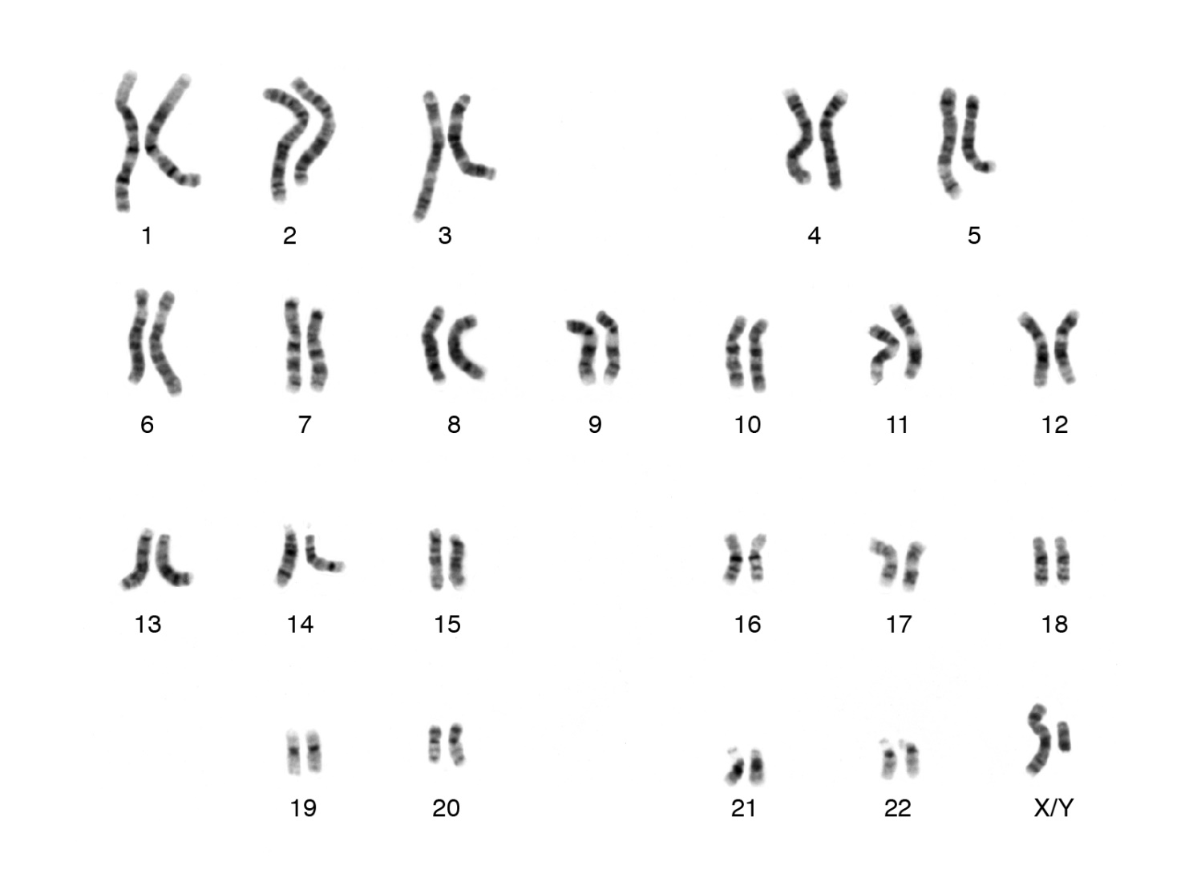
ATM
BRCA2
PALB2
BRCA1
CHEK2
Notes:
We all carry two copies of each of these genes. This is the chromosomes on which they are found.

Slide 13
Genes and cancer risk
Normal function of cancer genes: tumour suppression
Role in regulating cell division and replication or fixing damage
Pathogenic variant alters cancer gene
Does not work typically
If damage occurs to other copy of gene pair there is a higher chance of cancer
Notes:
OMIM and GeneReviews have detailed information

Slide 14
Implications of a pathogenic variant
Notes:
A gene can instruct how a protein should be made. A pathogenic variant may lead to a nonfunctional or absent protein.

Slide 15
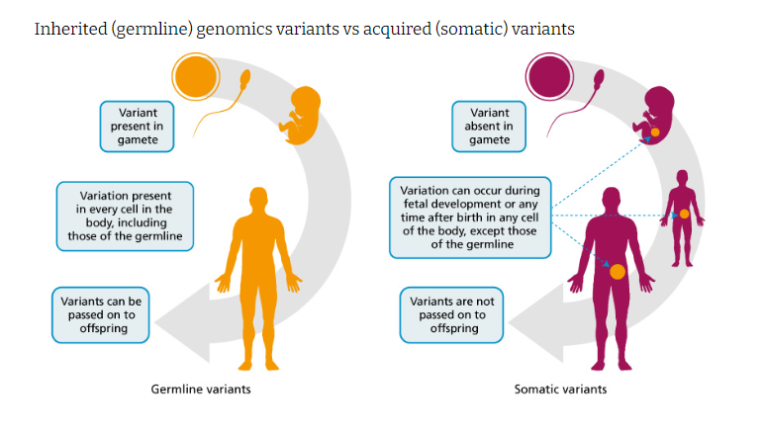
Germline variants – present in gametes and can be passed onto offspring (every cell in the entire organism will be affected)
Somatic variants – occur in a single body cell initially and cannot be inherited (only tissues derived from original altered cell are affected)
Most of this presentation refers to germline tests
Notes:
https://www.genomicseducation.hee.nhs.uk/cancer-genomics/ accessed 05.12.22

Slide 16
Which cancer depends on which gene is involved
Cancer risk is affected by sex and age of person
Penetrance affected by other genetic and lifestyle factors
Inheritance of risk is dominant https://www.genomicseducation.hee.nhs.uk/genotes/knowledge-hub/autosomal-dominant-inheritance/ accessed 27.02.23
https://visualsonline.cancer.gov/details.cfm?imageid=12495 accessed 05.12.22
Notes:
OMIM and GeneReviews have detailed information

Slide 17
Why dominant inheritance
Genes come in pairs (one on each copy of the chromosome)
Only one copy is passed on from each parent in egg/sperm
50% (1 in 2) chance of any gene from a pair gets passed on
Having the pathogenic variant causes the increased cancer risk – the risk is dominant over the other copy of the gene

Slide 18
Risk and disease penetrance

Slide 19
Management implications
What gene?
Significant family history?
Age?
Sex?
Life stage?
Family planning?
Current cancer histology?
prognosis?
Patient’s wishes?
Previous surgery?
Suitability for further surgery?
Living relatives in contact?
Interest in research?
Notes:
OMIM and GeneReviews have detailed information

Slide 20
Management implications
Does this affect treatment options?
PARP inhibitors? BRCA1 and BRCA2, possibly more
Refer to genomic medicine to consider:
Review chance of other cancers
Screening and risk management options
Family matters- testing for ‘at risk’ relatives
Research options

Slide 21
UK Cancer Genetics Group (CGG)
Subset of British Society for Genomic Medicine
Gene specific management guidance
https://www.ukcgg.org/information-education/ukcgg-leaflets-and-guidelines/

Slide 22
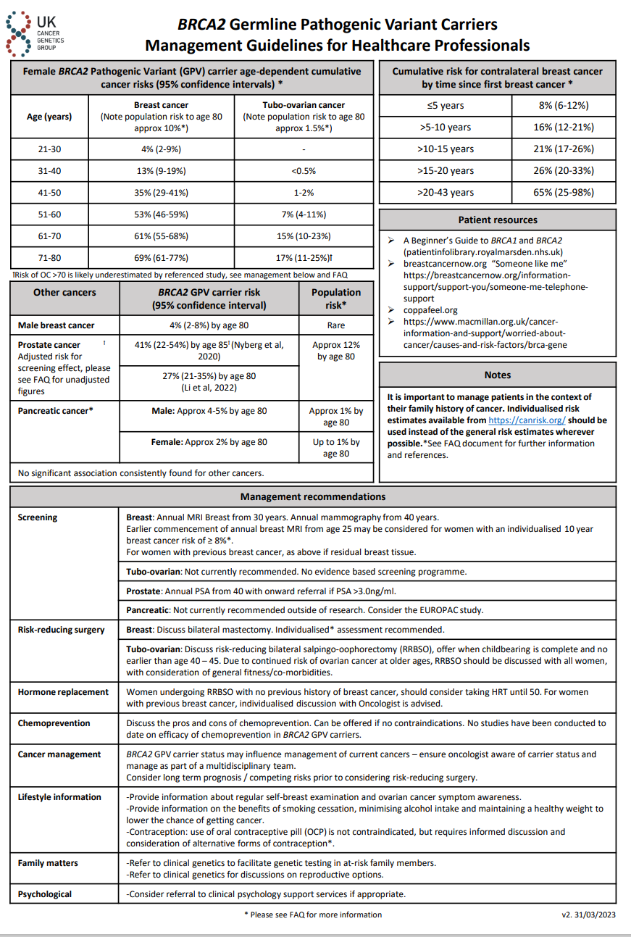
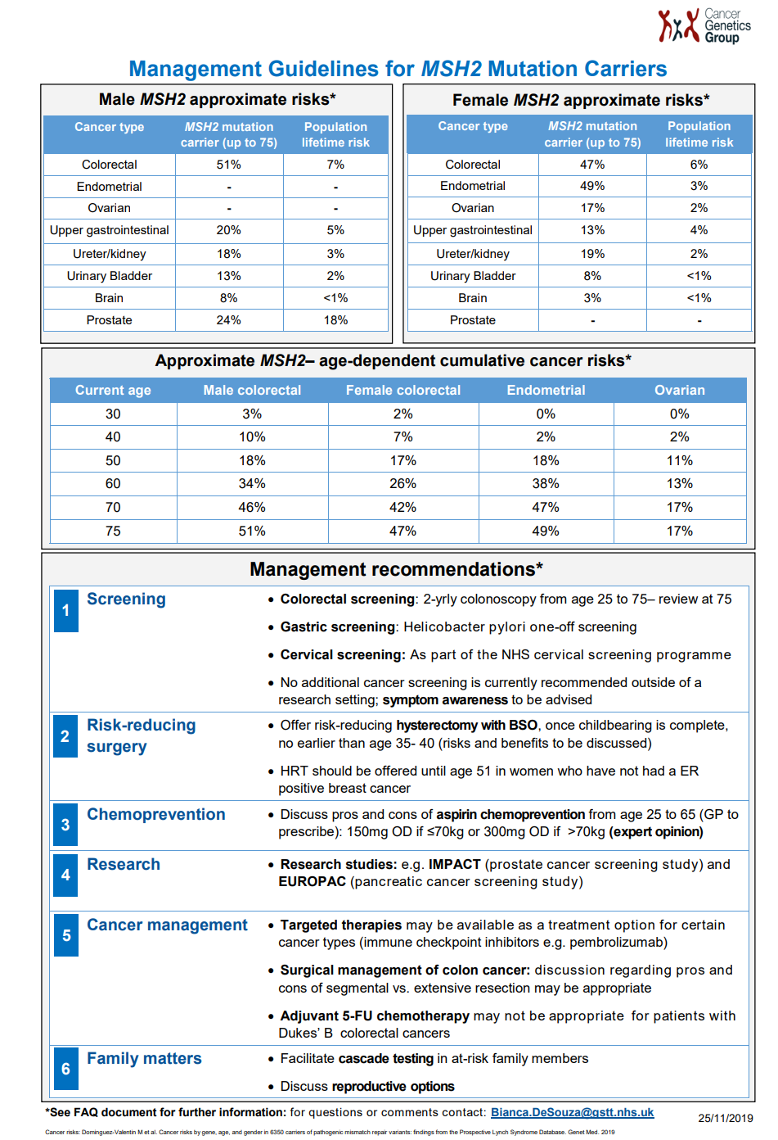
Notes:
UK Cancer Genetics Group guidelines https://www.ukcgg.org/information-education/ukcgg-leaflets-and-guidelines/ accessed 05.12.22

Slide 23
The future
Understanding, options and guidance will change over time
Family trees change over time
Cancer risk and management options will depend on genetic results and family history
National guidance including:
Cancer Genetics Group (CGG)
Genomic Test Directory
NICE

